Slide 1
http://www.youtube.com/watch?v=3Yi6NyXrUiU
Don Quixote

Slide 2
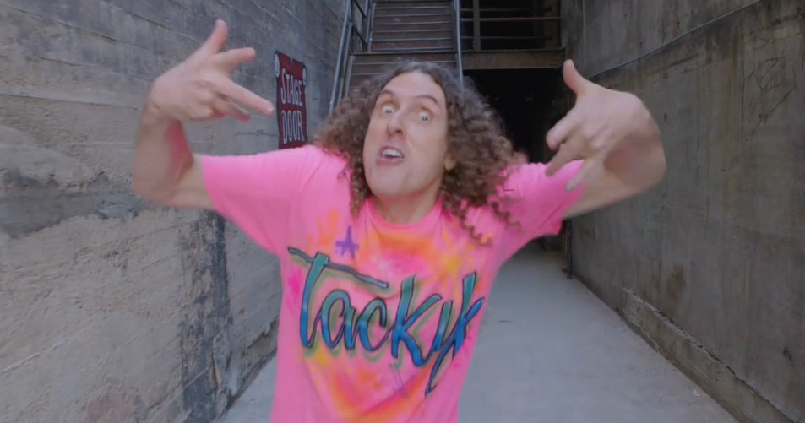
Weird Al
https://www.youtube.com/watch?v=zq7Eki5EZ8o
Based on the video, create a definition of parody.
1 a literary or musical work in which the style of an author or work is closely imitated for comic effect or in ridicule
2a feeble or ridiculous imitation

Slide 3
Cervantes
Read the background of Miguel de Cervantes.
What does the background say about
Personal adventures
Personal/financial challenges
The significance of his book

Slide 4
Concepts to think about
Look at the following pictures. What commonalities do you notice about:
Men
Women
Love
Bravery

Slide 5
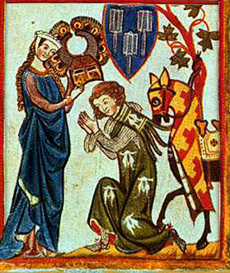
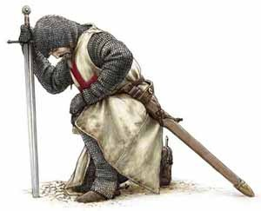
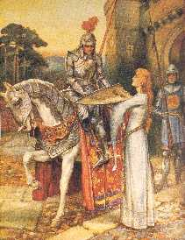
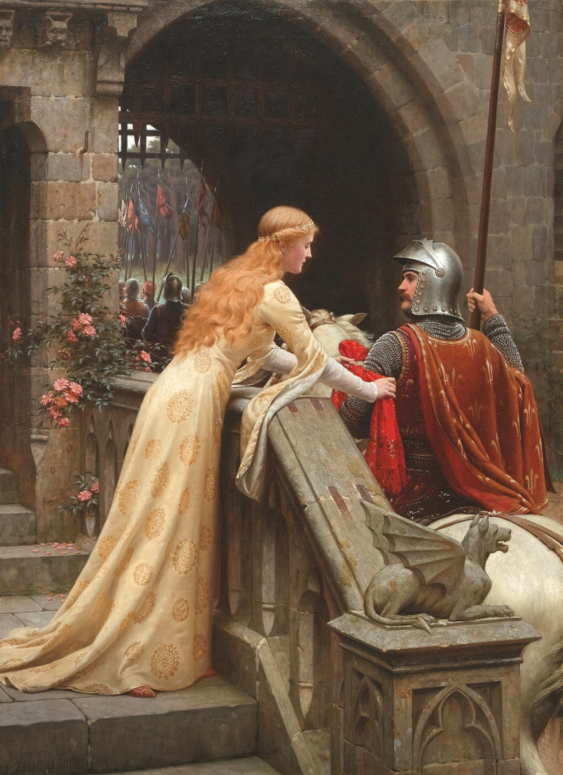
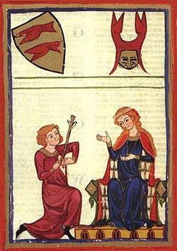

Slide 6
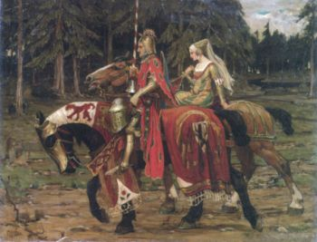
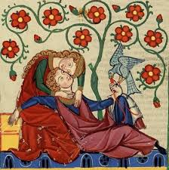
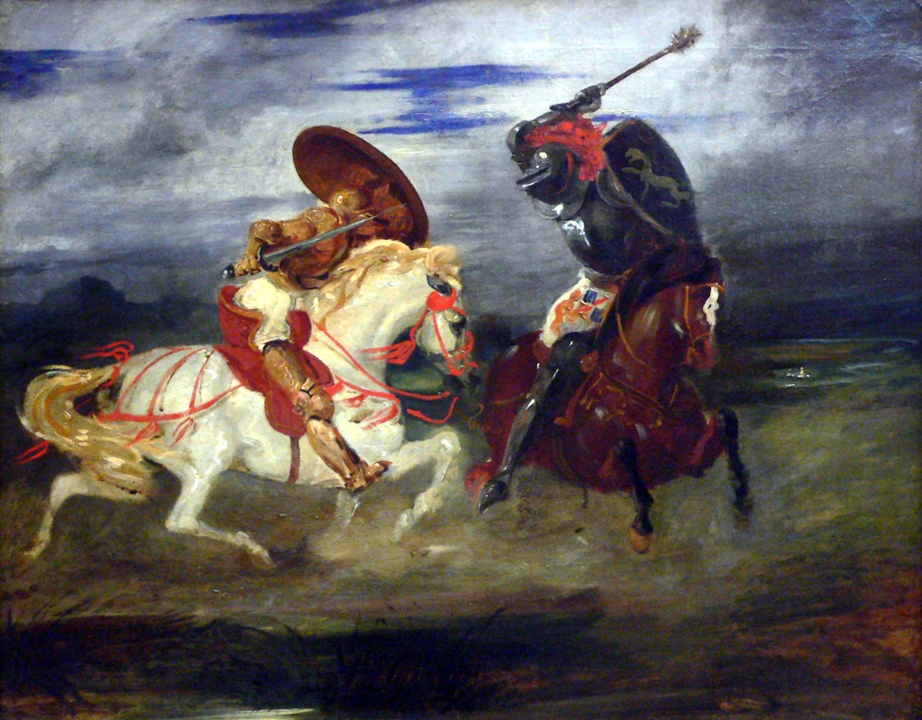
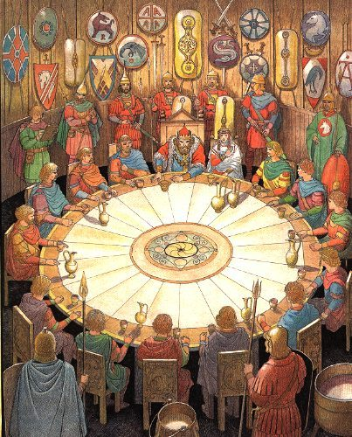

Slide 7
Medieval Romance: Legends of Knights

Slide 8
Conventions of Medieval Romance and Chivalry

Slide 9
Using the excerpt from Sir Gawain and the Green Knight, how are the characteristics of a knight portrayed?

Slide 11
Quick Write
What’s the difference between being a fan and being obsessed? Think of things that people are fans of. When do you think enthusiasm crosses the line into obsession?
https://www.youtube.com/watch?v=DRiuGCoKPT0

Slide 12
Don Quixote
The text parodies the Medieval literature that embodies the ideas of courtly love, knighthood, chivalry.
Create a chart on notebook paper that identifies quotes that help to develop the parody.
Quote (cite correctly) | Analysis of the parody

Slide 13
Motifs: Based on what you have read, how are the following motifs developed?
Chapter 1
The dangers of reading
The crazy fan
Parody of heroic adventure
Chapter 2
Continuation of the crazy fan
Parody of heroic adventure
Chapter 7
Character foils
Chapter 8
Character foils
Reality vs. fantasy

Slide 14
The Impossible Dream
The story of Don Quixote has, for many, become something beyond satire or parody. It seems to represent a man pursuing a dead, romantic ideal, and there is something beautiful in it. Even if Quixote is a ridiculous figure, he is on a noble quest to defeat wrong and to hold up precious ideals in a world that has become crass and practical, like poor Sancho on his burro.
The Broadway musical Man of La Mancha adapts the tale of Don Quixote and, though it is still clear that the old man is off his rocker, the beauty of his quest, the hopeless cause, is captured in the song “The Impossible Dream.”
https://www.youtube.com/watch?v=LgzXwpePTTU
Vocabulary:
Quixotic: extravagantly chivalrous or romantic; visionary, impractical, or impracticable.
Tilt at windmills: to fight battles with imaginary enemies; to fight against unimportant enemies or issues

Slide 15
Product
Use the “Conventions of Medieval Romance” and create a new adventure for Don Quixote that parodies a concept of Medieval literature or poetry.
It must be in dialogue form between Don Quixote and either Sancho Panza or Dulcinea de Toboso .
It can deal with love, chivalry, adventure, bravery, etc.

