Slide 1
Dante’s Inferno
Visions of Hell

Slide 2
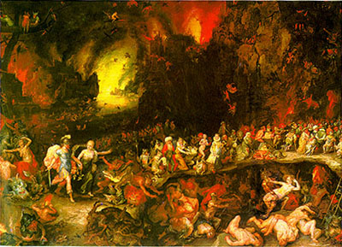
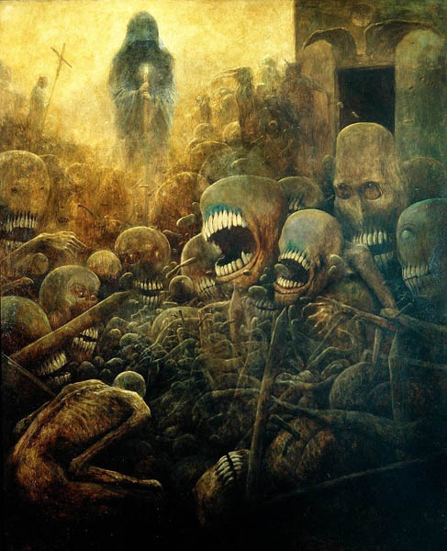
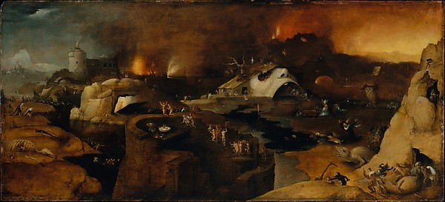

Slide 3
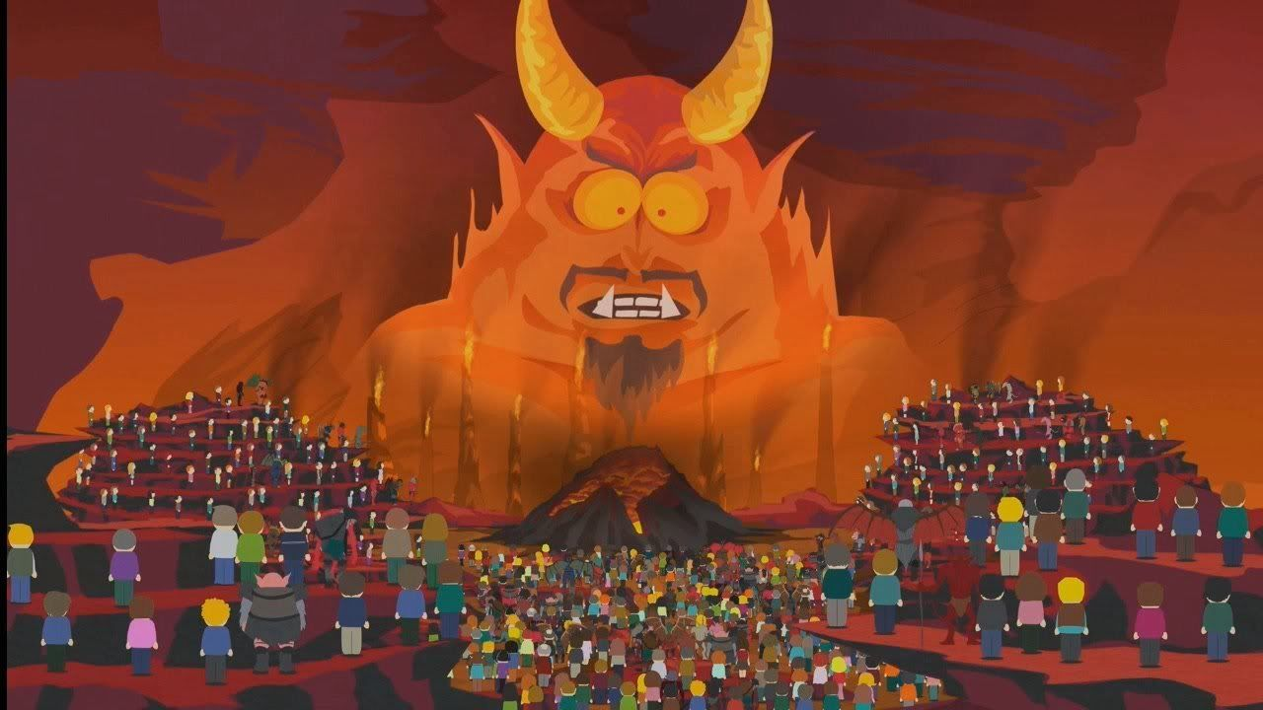
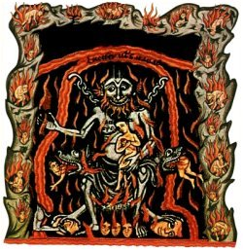
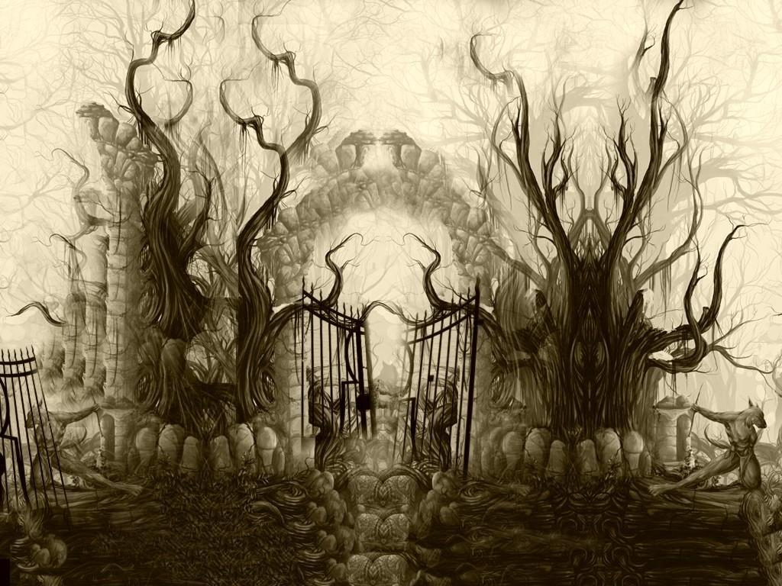

Slide 4
The GREEK Underworld
Rulers: Hades and Persephone
Location
Beneath secret places of earth (Iliad)
Over edge of world, across ocean (Odyssey)
Various entrances in caverns & deep lakes (later poetry)
Rivers separating underworld from earth
Acheron: woe
Phlegethon: fire
Cocytus: lamentation
Lethe: forgetfulness
Styx: the unbreakable oath

Slide 5
Important Figures
Cerberus: 3-headed dog guards entrance (you can come in, but you can’t leave)
Judges: Minos, Aeacus, Rhadamanthus
Erinyes (Furies)
Greeks believed they pursued sinners on earth
Romans placed them in underworld, punishing dead sinners
Sleep and Death: brothers, send dreams from underworld through 2 gates
Horn: true dreams
Ivory: false dreams
Divisions of the Underworld
Tartarus
Prison of sons of earth
Deepest region
Wrongdoers are punished here
Erebus: where the dead pass &
are judged when they die
Elysian Fields: place of blessedness,
where the good go

Slide 6
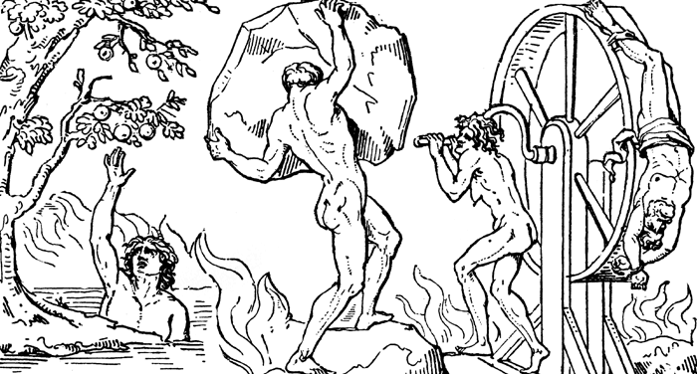
Some Suffering Sinners in the Underworld
Tityus: tried to rape Zeus’ mother, so bound to earth; vultures tear out his liver daily
Ixion: tried to seduce Hera, so was bound to a spinning, flaming wheel for eternity
Sisyphus: betrayed a secret of Zeus, so now he spends eternity pushing a boulder up a hill, only to have it roll down before he can get to the very top
The Danaids: 49 sisters who murdered their grooms and now have to fill barrels that are full of holes (spoiler: it always drains out)
Tantalus: he’s the worst! He served his own children to gods for dinner. His punishment? He stands waist-deep in a pool of clear, fresh water, under a tree full of juicy ripe fruit. He is super thirsty and super hungry, but when he reaches for fruit, the branches pull back, and when he tries to drink, the water recedes. So he’s surrounded by food and water and can have none.
*****tantalize: to dangle the bait, always just out of reach!

Slide 7
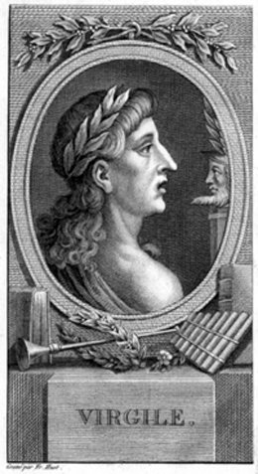
Virgil’s Account of the Underworld
In Hamilton’s Mythology book, read pages 317-322 (“The Descent into the Lower World”)
Who are some of the characters/types of people Aeneas encounters in the Underworld?
What are some of the punishments?

Slide 8
Background on Dante Alighieri
1265-1321
Born in Florence, Italy
Met and fell in love with Beatrice as a child
She died before a disagreement could be resolved
Dante never got over her, includes her in his writings including later parts of The Divine Comedy
Incredible political unrest
Several civil wars in Florence
Believed Church should only have spiritual role in the lives of the people (separate from political role)
Sentenced to die by political enemies (Black Guelphs) while in exile
Wrote The Divine Comedy in the last years of his life

Slide 9
The Divine Comedy
Purposes:
Political
Wanted to punish people he opposed
Not funny ha-ha
Happy ending (starting with Hell and ending with Heaven)
Written in the vernacular (usually seen with comedies)
Epic poem
Medieval allegorical vision of the afterlife
Three parts, 33 Cantos with a Canto to introduce each (total 100):
Inferno (Hell)
Purgatorio (Purgatory)
Paradiso (Heaven)
Virgil then Beatrice guide Dante

Slide 10
