Slide 2
Dante’s Inferno
Cantos

Slide 3
Canto 1: The Dark Wood of Error
Read handout for Canto 1 (lines 1-60)
Answer the following question:
Dante says in line 12 of Canto 1 that he has wandered from the “True Way.” If the “Dark Wood of Error” is a symbol of worldliness, what does the True Way represent? On an allegorical level, what might the three animals that try to force Dante back into the Dark Wood represent?

Slide 4
Canto 3: The Vestibule of Hell
The Opportunists
“Neither for good nor evil but only for themselves”
Uncommitted one way or another; never chose sides in Rebellion of Angels
Reside on shores of Acheron (not in Hell or outside of it)
Punishment:
race around chasing a banner that flows through dirty air
chased by wasps and hornets that sting them constantly and draw blood and puss
worms and maggots feast on sores
Took no sides so no real consistent location
Always changing direction (chasing banner)
Choose no lighted path so much run around in dark
Stinging bugs mirror guilty conscience
Moral filth = physical filth
New souls gathered by Charon
Inscription:
“I AM THE WAY INTO THE CITY OF WOE.
I AM THE WAY TO A FORSAKEN PEOPLE.
I AM THE WAY INTO ETERNAL SORROW.
SACRED JUSTICE MOVED MY ARCHITECT.
I WAS RAISED HERE BY DIVINE OMNIPOTENCE,
PRIMORDIAL LOVE AND ULTIMATE INTELLECT.
ONLY THOSE ELEMENTS TIME CANNOT WEAR
WERE MADE BEFORE ME, AND BEYOND TIME I STAND.
ABANDON ALL HOPE YE WHO ENTER HERE.”

Slide 5
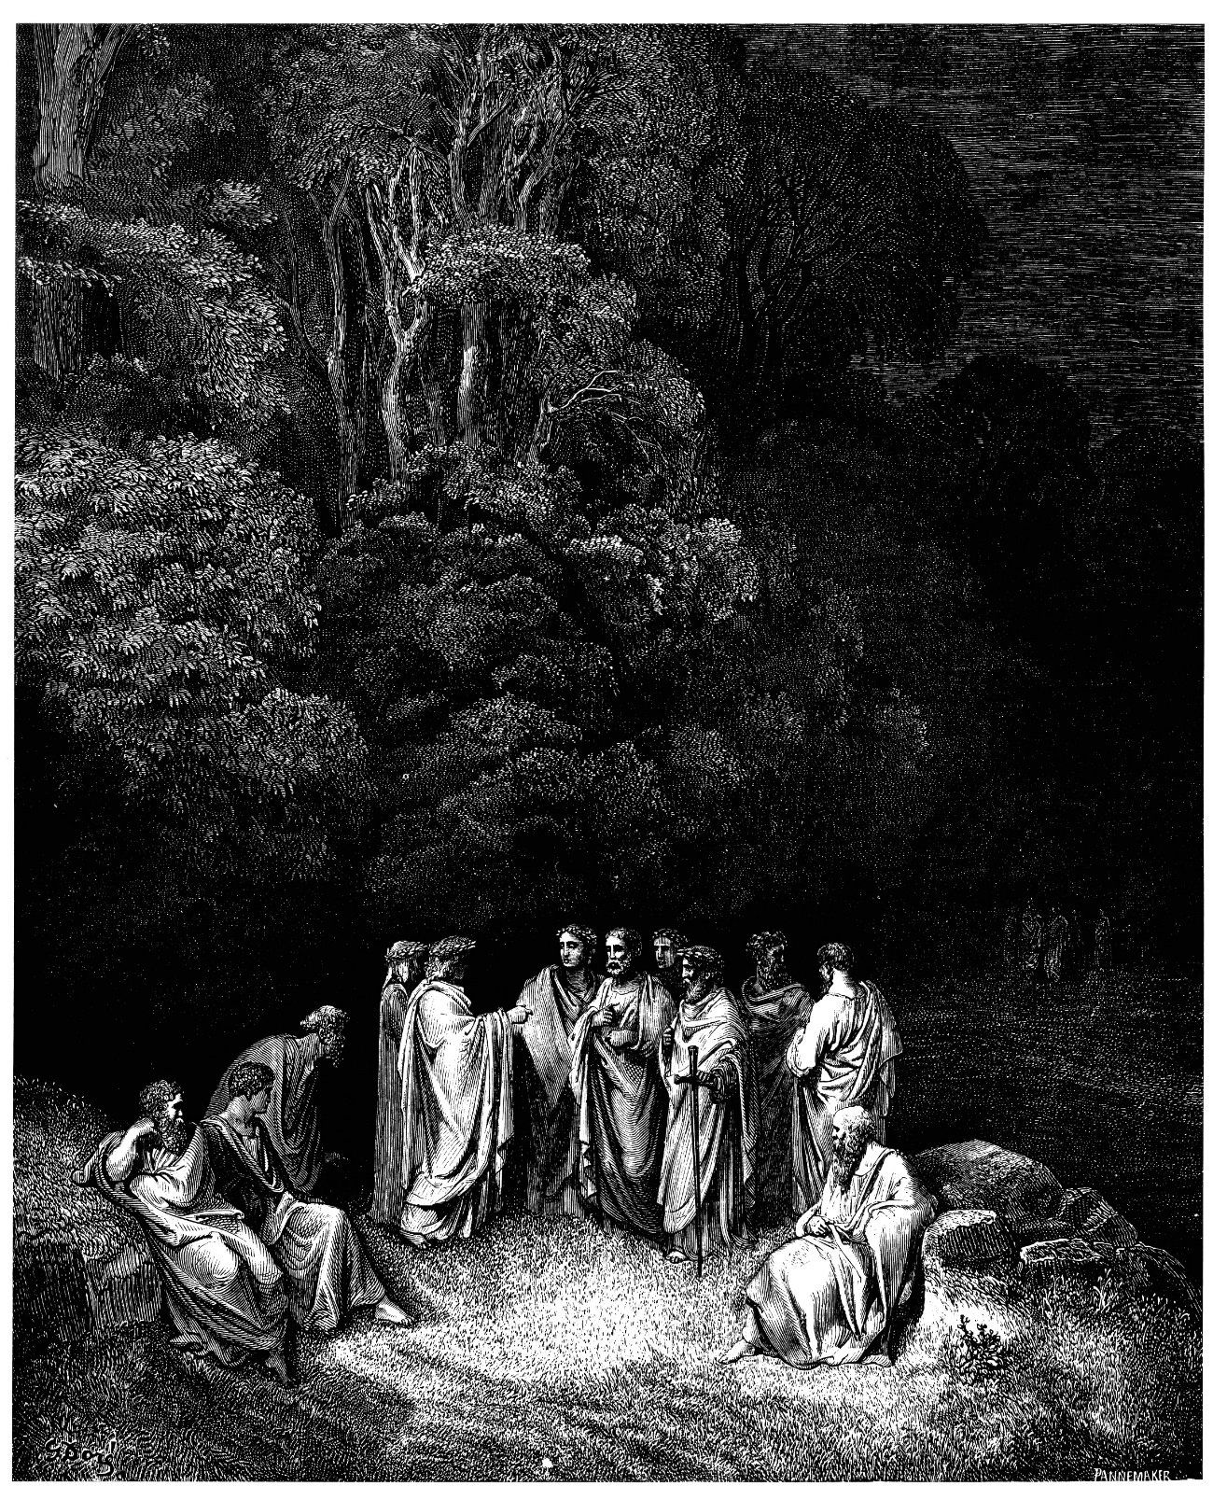
Circle One: Limbo
Inhabitants: non-Christians and unbaptized pagans
Punishment: eternity in an inferior form of Heaven

Slide 6
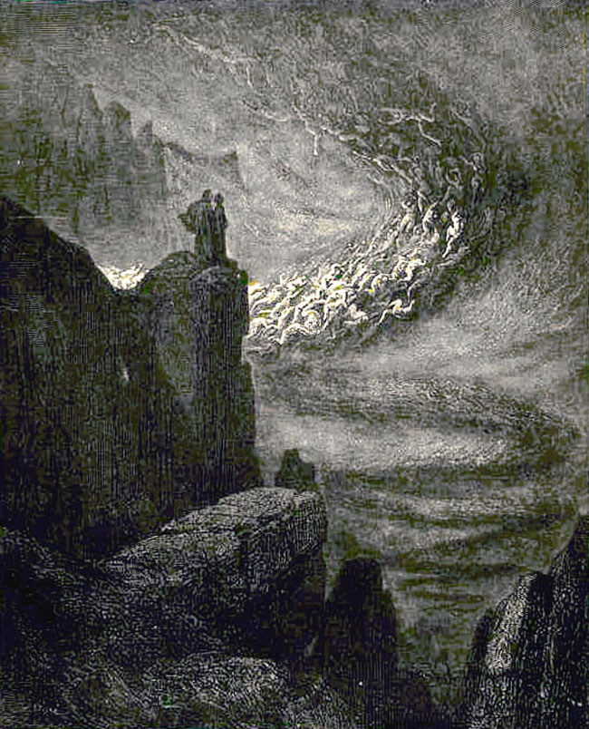
Circle Two: Lust
Inhabitants: those ruled by physical desire
Punishment: blown violently back and forth by strong winds, preventing them to find peace and rest

Slide 7
Canto 5: The Carnal
Read handout for Canto 5
Answer the following questions:
In Canto 5, lines 82-87, Dante compares Paolo and Francesca to doves. Why do you suppose Dante uses such a sympathetic image for the lovers?
By including details about Paolo and Francesca’s reading, what attitude do you think Dante is expressing toward courtly-love poetry?
Why are the following allusions important? Why does Dante include fictional characters as well as real people?
Dido, Cleopatra, Helen, Achilles, Paris, and Tristan

Slide 8
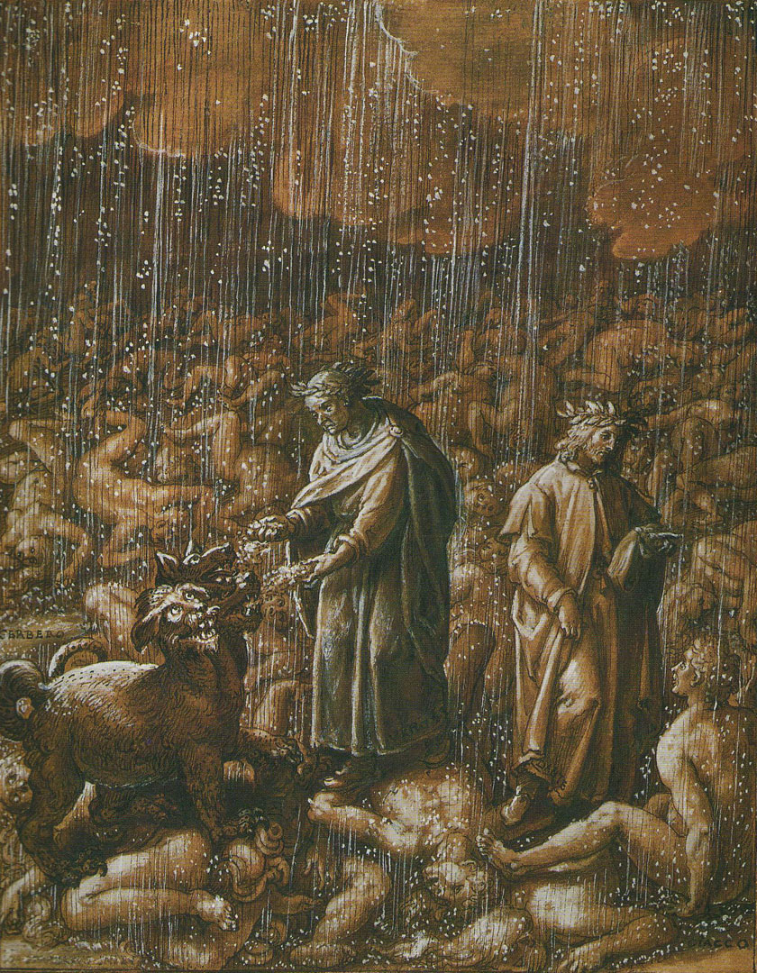
Circle Three: Gluttony
Inhabitants: excessive indulgers (eating/drinking)
Punishment: forced to lie in a vile slush that is produced by never-ending icy rain

Slide 9
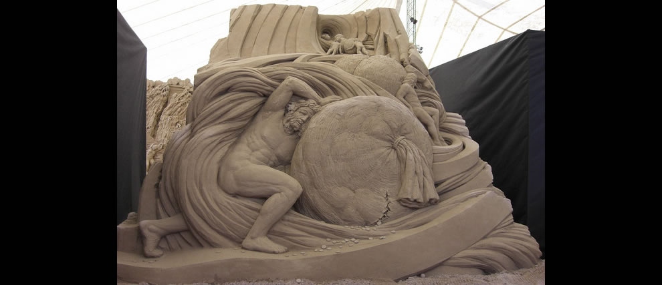
Circle Four: Greed
Inhabitants: those who hoarded possessions and those who lavishly spent
Punishment: the two groups joust, using as weapons great weights which they push with their chests

Slide 10
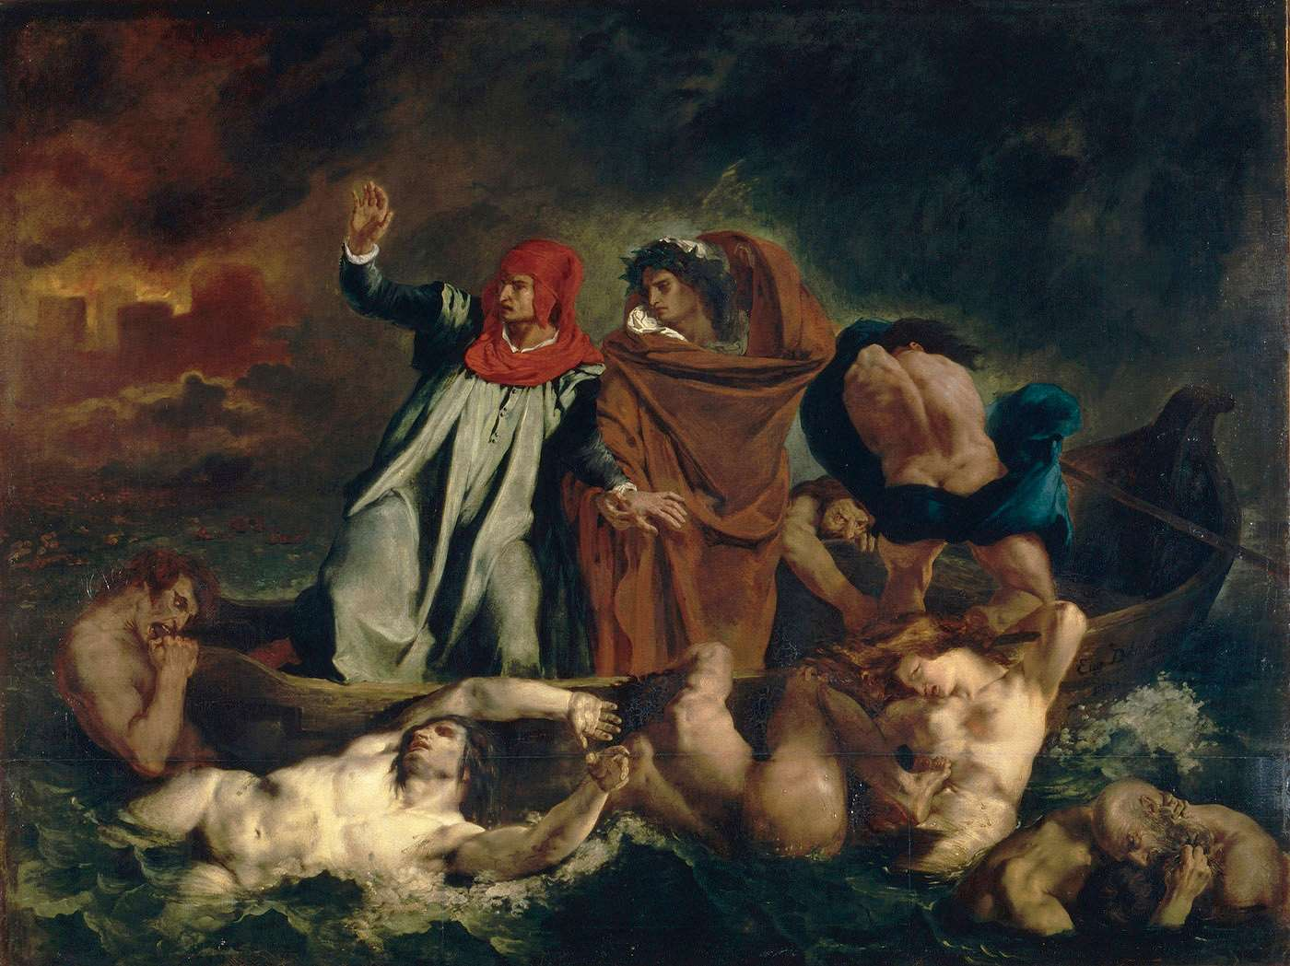
Circle Five: Wrath
Inhabitants: the angry and sullen
Punishment: the wrathful fight each other on the surface of the river Styx and the sullen gurgle beneath the surface

Slide 11
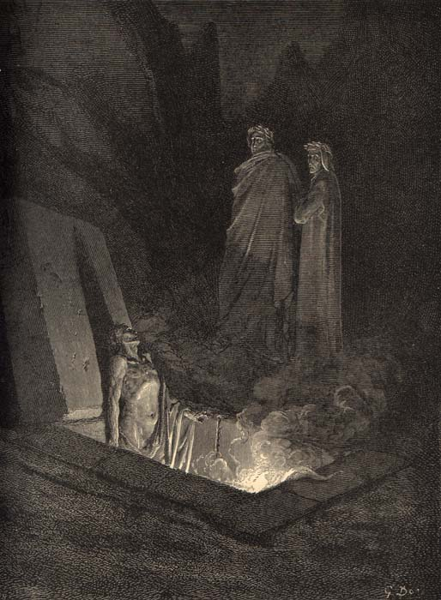
Circle Six: Heresy
Inhabitants: those who doubted or denied the Christian faith
Punishment: condemned to eternity in flaming tombs

Slide 12
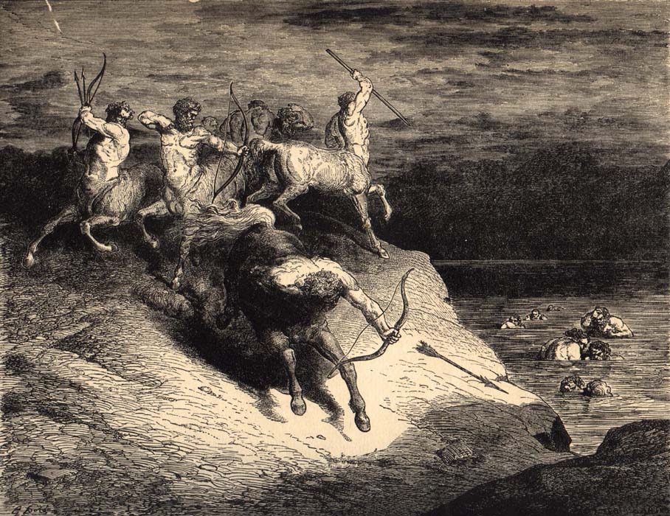
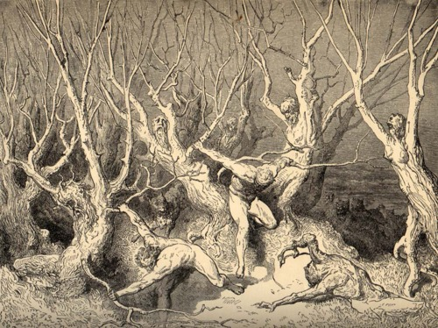
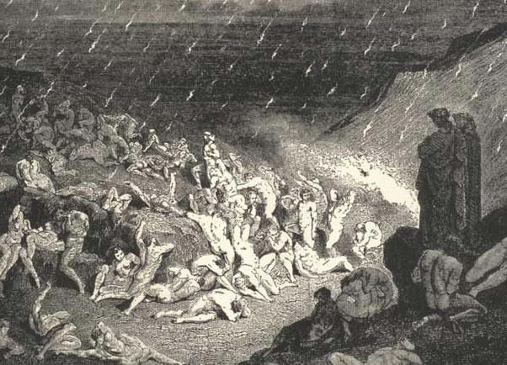
Circle Seven: Violent
Outer ring: violent against others/property
Punishment: sunk into a river of boiling blood and fire
2. Middle ring: violent against self (suicides)
Punishment: turned into trees and bushes which are fed upon by harpies
3. Inner ring: violent against God and nature (blasphemers and sodomites)
Punishment: reside in a desert of burning sand and rain falling from the sky

Slide 13
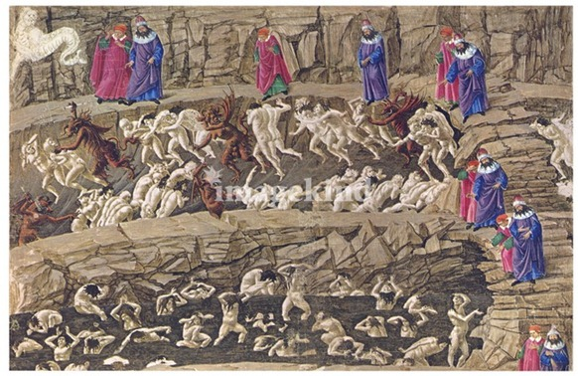
Bolgia 1: panderers and seducers
Punishment: whipped by demons
Circle Eight: Fraud
Bolgia 2: flatterers
Punishment: submerged in human excrement
Bolgia 3: simony (the making of profit out of sacred things)
Punishment: buried head-first with flames burning their feet
Bolgia 4: sorcerers, astrologers, and false prophets
Punishment: have their heads twisted around on their bodies backward
Bolgia 5: corrupt politicians
Punishment: immersed in a lake of boiling pitch
Bolgia 6: hypocrites
Punishment: apathetically walk along wearing gold-plated
lead cloaks
Bolgia 7: thieves
Punishment: bitten and transformed by snakes and lizards
Bolgia 8: evil counselors and advisers
Punishment: individually covered in fire
Bolgia 9: divisive individuals (start drama)
Punishment: sword-wielding demon cuts them into pieces
Bolgia 10: alchemists, counterfeiters, perjurers, and impostors
Punishment: afflicted with different diseases

Slide 14
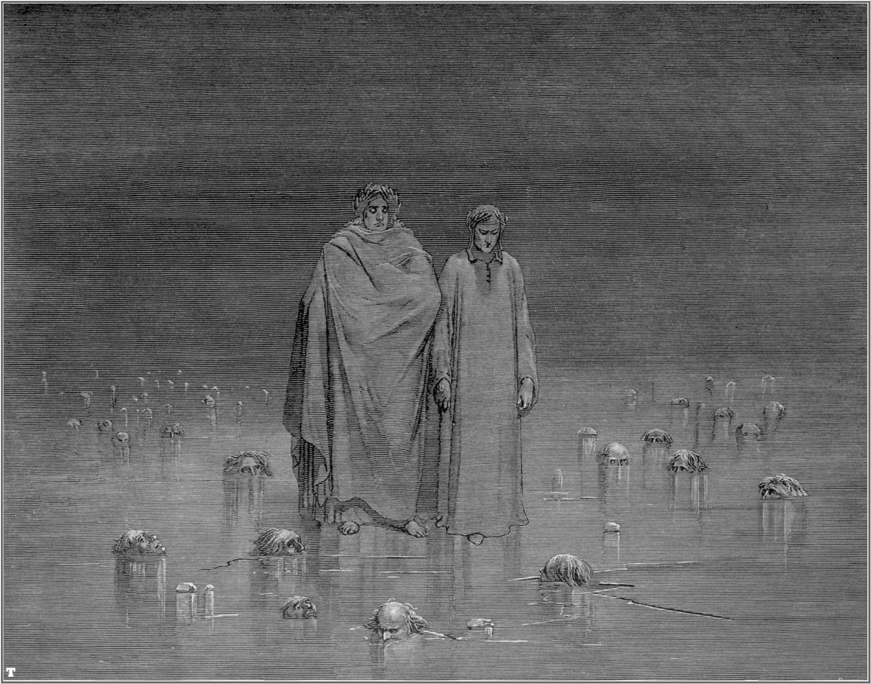
Circle Nine: Treachery
Round 1: named Caïna, after Cain, who killed his own brother; traitors to kindred
Punishment: immersed in the ice up to their chins with heads bent forward
Round 2: named Antenora, after Antenor of Troy, who betrayed his city to the Greeks; traitors to political entities
Punishment: immersed in the ice up to their chins
Round 3: named Ptolomaea, after Ptolemy, who invited father- and brothers-in-law to a banquet and then killed them; traitors to their guests
Punishment: lying on backs, fully covered in ice except their faces
Round 4: named Judecca, after Judas Iscariot, Biblical betrayer of Christ; traitors to their lords and benefactors
Punishment: completely covered in ice

Slide 15
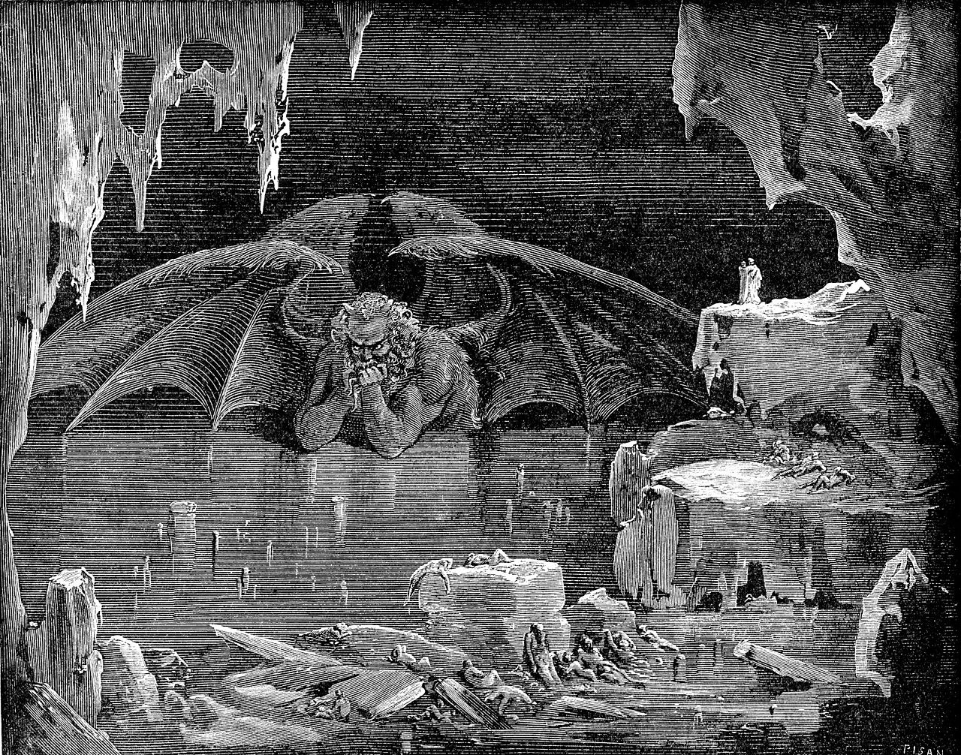
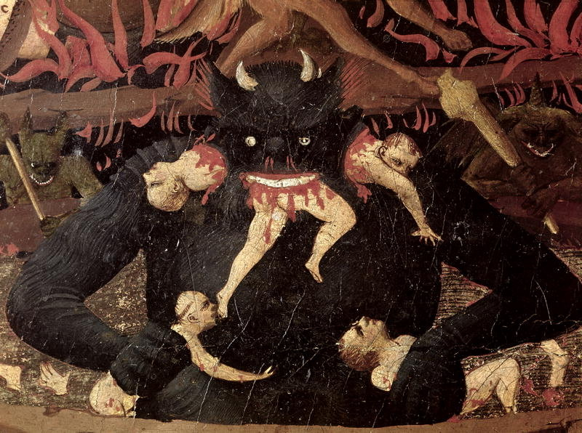
Circle Nine, Center of Earth: Satan
Satan, half submerged in ice, gnaws on Brutus, Cassius, and Judas with his three mouths

Slide 16
Canto 34: Compound Fraud, The Treacherous to Their Masters, and Satan
Read the handout for Canto 34
Answer the following questions:
In Canto 34, why does Dante regard Judas, Brutus, and Cassius as the worst sinners of all? How does Judas’s sin differ from that of Brutus and Cassius?
In what way could Satan’s three faces be explained as symbols?

Slide 17
Extension questions:
Dante ranks human sins by his placement of different sinner in Hell. Does their punishment fit their crimes? Explain.
Honors:
What importance does Dante place on reason? What generalization can you make about Dante’s view of reason? Use evidence in the poem to make your generalization.
In his introduction to the Inferno, Archibald T. MacAllister states that Dante believed “that the mind must be moved in order to grasp what the senses present to it; therefore he combines sight, sound, hearing, smell and touch with fear, pity, anger, horror and other appropriate emotions to involve his reader to the point of seeming actually to experience his situations and not merely to read about them.” Do you agree that Dante’s use of images effectively draws readers into his story and makes them feel strong emotions? Explain, using specific examples from the selection.

