Slide 1
Warm-up: “The Lion’s Awakening”
Write the objective:
Analyze characterization, archetypes, themes, and cultural messages in an African epic.
Respond to the following quote:
“If a man does not keep pace with his companions, perhaps it is because he hears a different drummer. Let him step to the music which he hears, however measured or far away.”
-Henry David Thoreau
What do you think is Thoreau’s central idea?
What words in the quote support this idea?
[RL 1 (textual support); RL 2 (theme/main idea)]

Slide 2
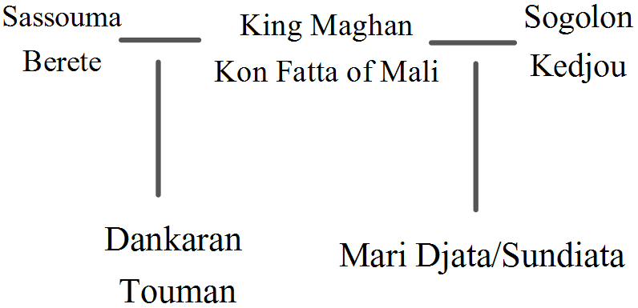
Annotations for “The Lion’s Awakening” (on a separate sheet of paper) Do NOT write on my story!
Sogolon Kedjou and Sassouma Berete:
Archetypes
Source of feminine identity
Sundiata
Archetypal Situation
Archetypal Character
Irony (Situational)
Qualities of a hero
Cultural conclusion
Farakourou
The role of fate/destiny (trace throughout the selection)
Songs in the selection: how do they develop the narrative?

Slide 3
Constructed Response: “The Lion’s Awakening”
How does the author develop a theme in this selection?
No more than 5 lines
Topic sentence that clearly and specifically answers the question
Elaboration and supporting details from the text
Concluding sentence that sums up the significance of your response.

Slide 4
Warm-up: “Krina”
Write the objective
Let’s talk smack talk.
In what situations do we find people “talking smack”?
What makes smack talk work? (What constitutes “good” smack/shade/slaying?)
When and how might smack talk go wrong?
Trash Talk Clip

Slide 5
Annotations for “Krina”
Effect of figurative language in the “smack talk” scene
Role of family unity (or betrayal) in the outcome of Sundiata’s battle with Soumaoro
Archetypes
Role of fate
Cultural messages we can derive from the selection

Slide 6
Venn Diagram: Sundiata
Compare and contrast the two epics we have sampled: The Iliad and Sundiata.
Consider and choose from the following points of comparison and contrast:
The heroes themselves
Use of language
Role of fate and/or prophecy
Concepts of honor
Role of women
Supernatural intervention

