Slide 1
INFERNO

Slide 2
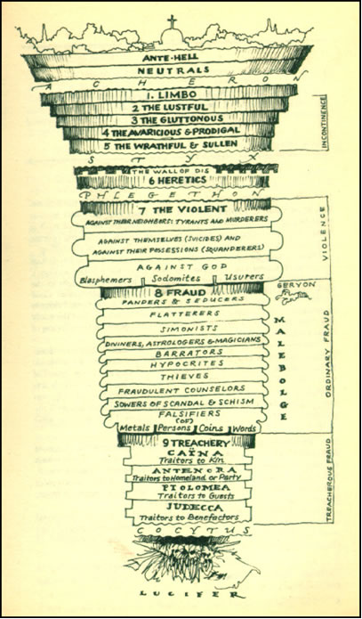
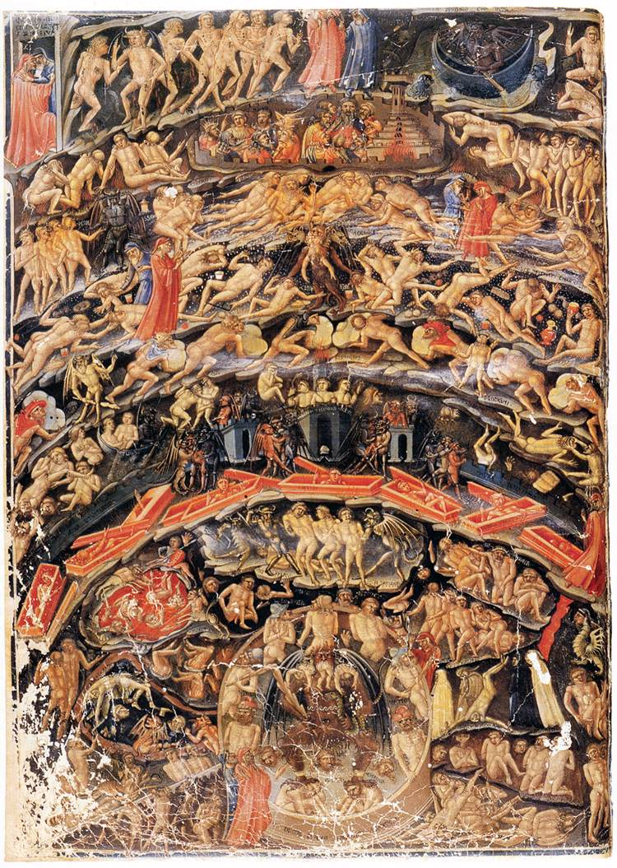

Slide 3
CANTO 3: THE VESTIBULE OF HELL
The Opportunists
“Neither for good nor evil but only for themselves”
Uncommitted one way or another; never chose sides in Rebellion of Angels
Reside on shores of Acheron (not in Hell or outside of it)
Punishment:
race around chasing a banner that flows through dirty air
chased by wasps and hornets that sting them constantly and draw blood and puss
worms and maggots feast on sores
Contrapasso:
Took no sides so no real consistent location
Always changing direction (chasing banner)
Choose no lighted path so must run around in dark
Stinging bugs mirror guilty conscience
Moral filth = physical filth
New souls gathered by Charon
Inscription: “I AM THE WAY INTO THE CITY OF WOE. I AM THE WAY TO A FORSAKEN PEOPLE. I AM THE WAY INTO ETERNAL SORROW. SACRED JUSTICE MOVED MY ARCHITECT. I WAS RAISED HERE BY DIVINE OMNIPOTENCE, PRIMORDIAL LOVE AND ULTIMATE INTELLECT. ONLY THOSE ELEMENTS TIME CANNOT WEAR WERE MADE BEFORE ME, AND BEYOND TIME I STAND. ABANDON ALL HOPE YE WHO ENTER HERE.”

Slide 4
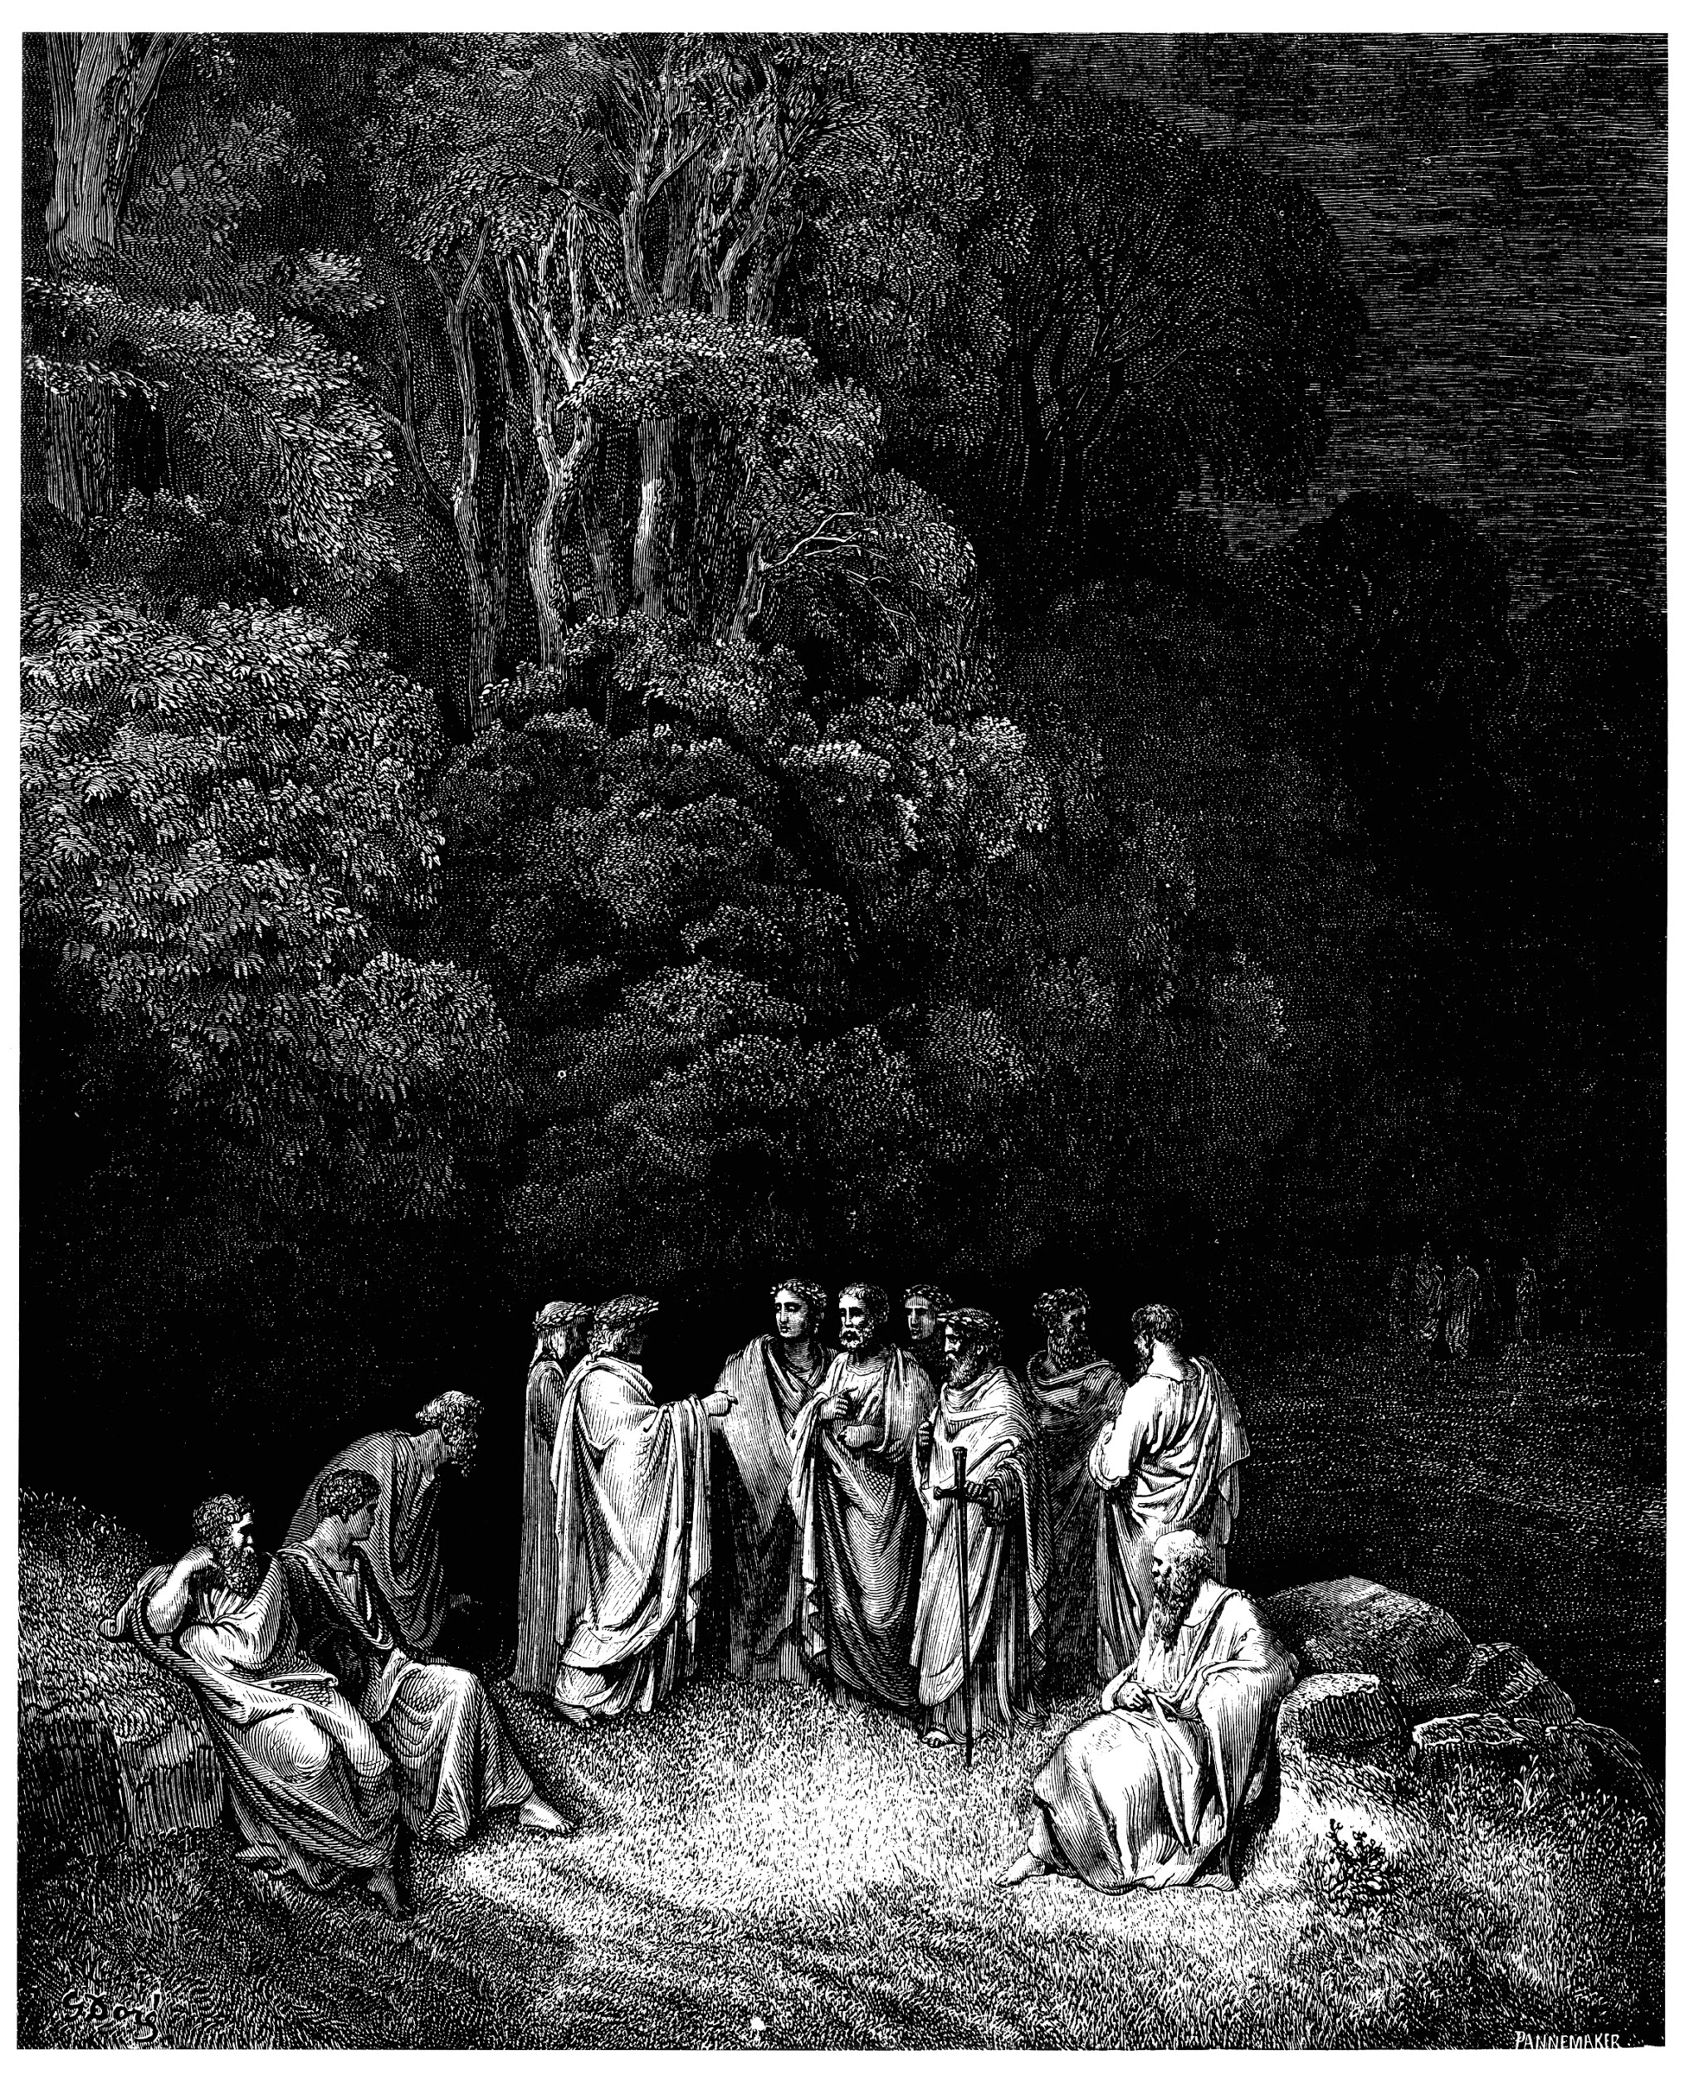
Circle One: Limbo
Inhabitants: non-Christians and unbaptized pagans
Punishment: eternity in an inferior form of Heaven

Slide 5
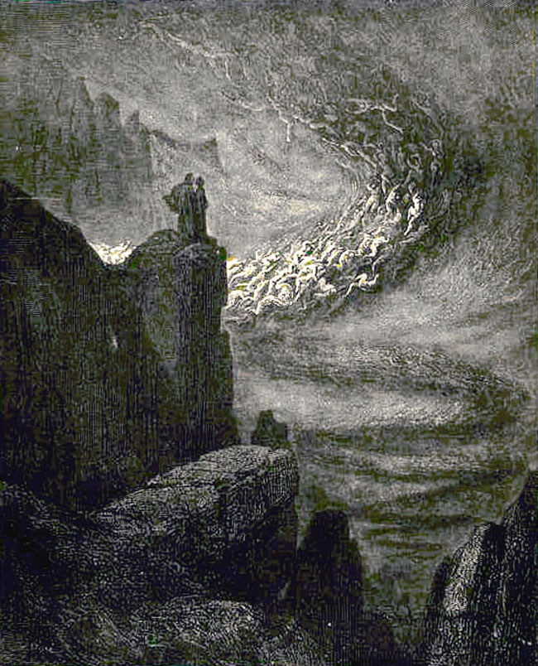
Circle Two: Lust
Inhabitants: those ruled by physical desire
Punishment: blown violently back and forth by strong winds, preventing them from finding peace and rest

Slide 6
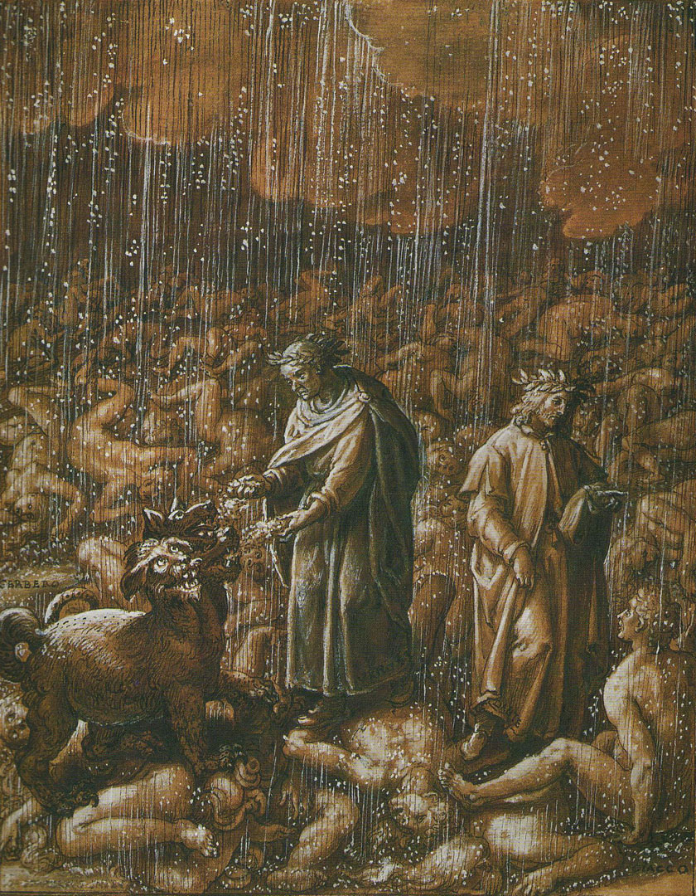
Circle Three: Gluttony
Inhabitants: excessive indulgers (eating/drinking)
Punishment: forced to lie in a vile slush that is produced by never-ending icy rain

Slide 7
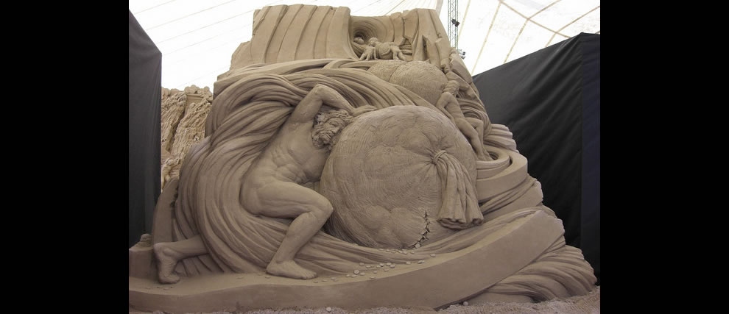
Circle Four: Greed
Punishment: the two groups joust, using great weights which they push with their chests
Inhabitants: those who hoarded possessions and those who lavishly spent

Slide 8
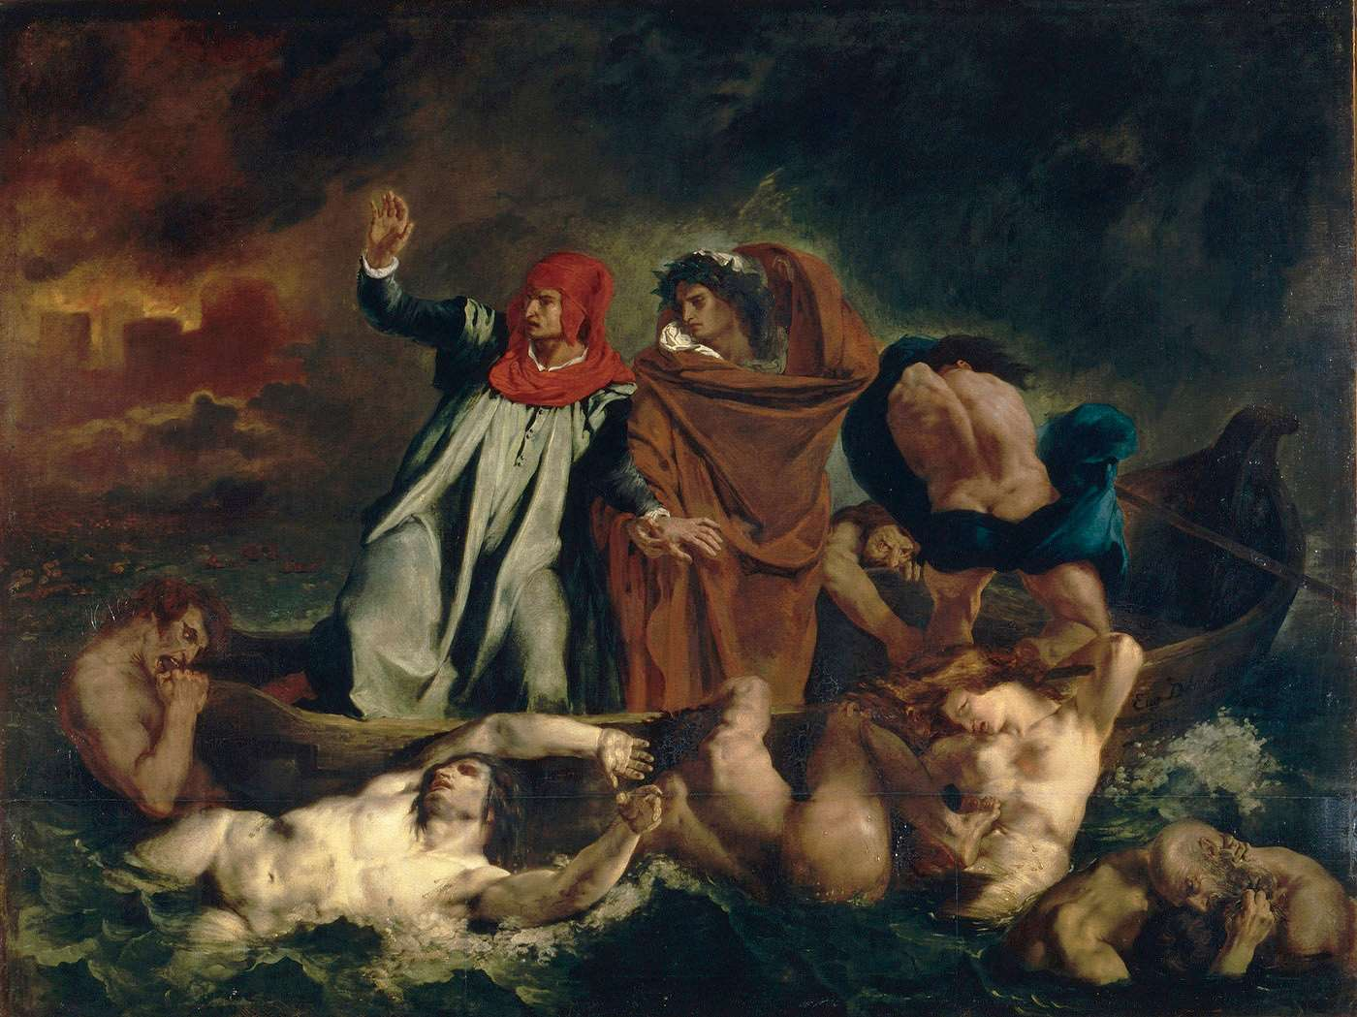
Circle Five: Wrath
Inhabitants: the angry and sullen
Punishment: the wrathful fight each other on the surface of the river Styx and the sullen gurgle beneath the surface

Slide 9
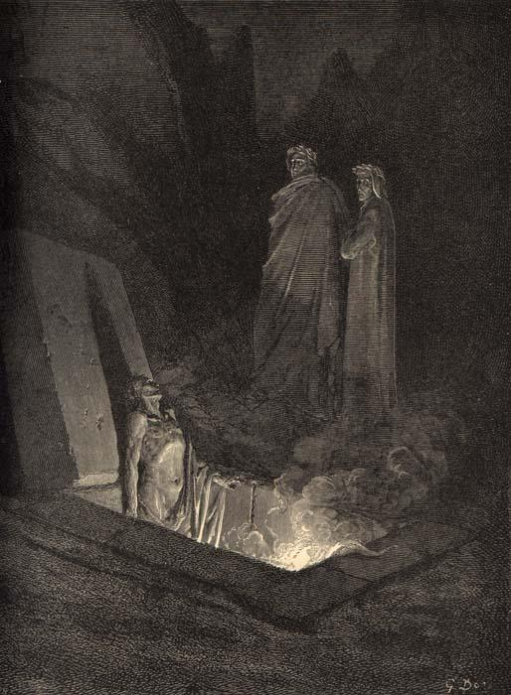
Circle Six: Heresy
Inhabitants: those who doubted or denied the Christian faith
Punishment: condemned to eternity in flaming tombs

Slide 10
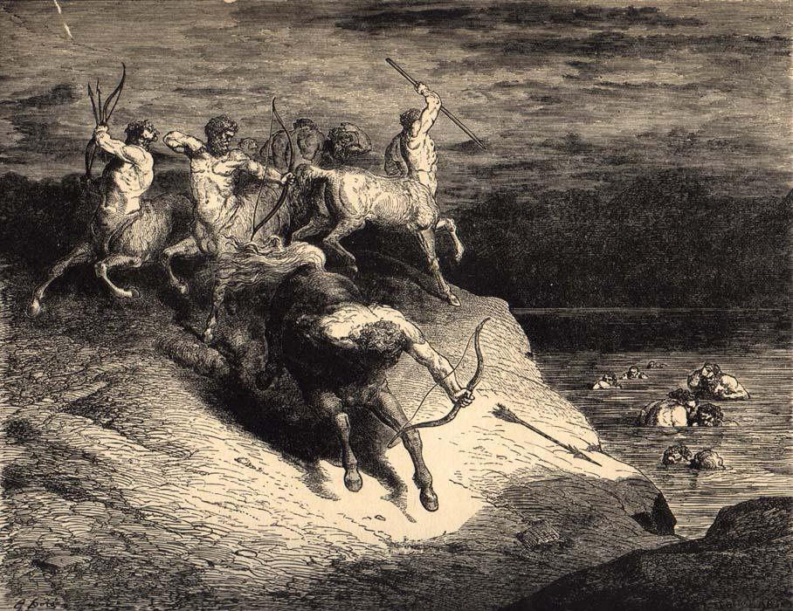
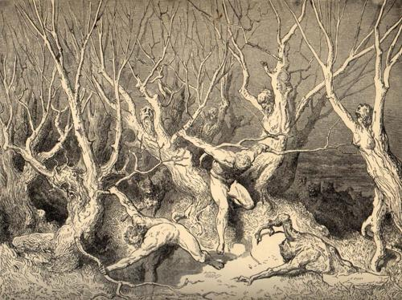
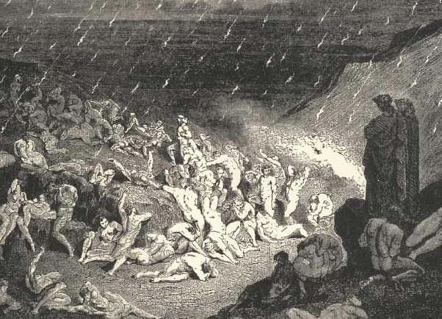
Outer ring: violent against others/property
Punishment: sunk into a river of boiling blood and fire
Circle Seven: Violent
2. Middle ring: violent against self (suicides)
Punishment: turned into trees and bushes which are fed upon by harpies
3. Inner ring: violent against God and nature (blasphemers and sodomites)
Punishment: reside in a desert of burning sand and rain falling from the sky

Slide 11
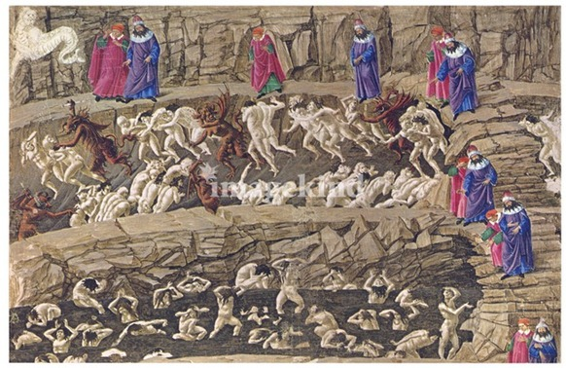
Bolgia 1: panderers and seducers
Punishment: whipped by demons
Bolgia 2: flatterers
Punishment: submerged in human excrement
Circle Eight: Fraud
Bolgia 3: simony (the making of profit out of sacred things)
Punishment: buried head-first with flames burning their feet
Bolgia 4: sorcerers, astrologers, and false prophets
Punishment: have their heads twisted around on their bodies backward
Bolgia 5: corrupt politicians
Punishment: immersed in a lake of boiling pitch
Bolgia 6: hypocrites
Punishment: apathetically walk along wearing gold-plated lead cloaks
Bolgia 7: thieves
Punishment: bitten and transformed by snakes and lizards
Bolgia 8: evil counselors and advisers
Punishment: individually covered in fire
Bolgia 9: divisive individuals (start drama)
Punishment: sword-wielding demon cuts them into pieces
Bolgia 10: alchemists, counterfeiters, perjurers, and impostors
Punishment: afflicted with different diseases

Slide 12
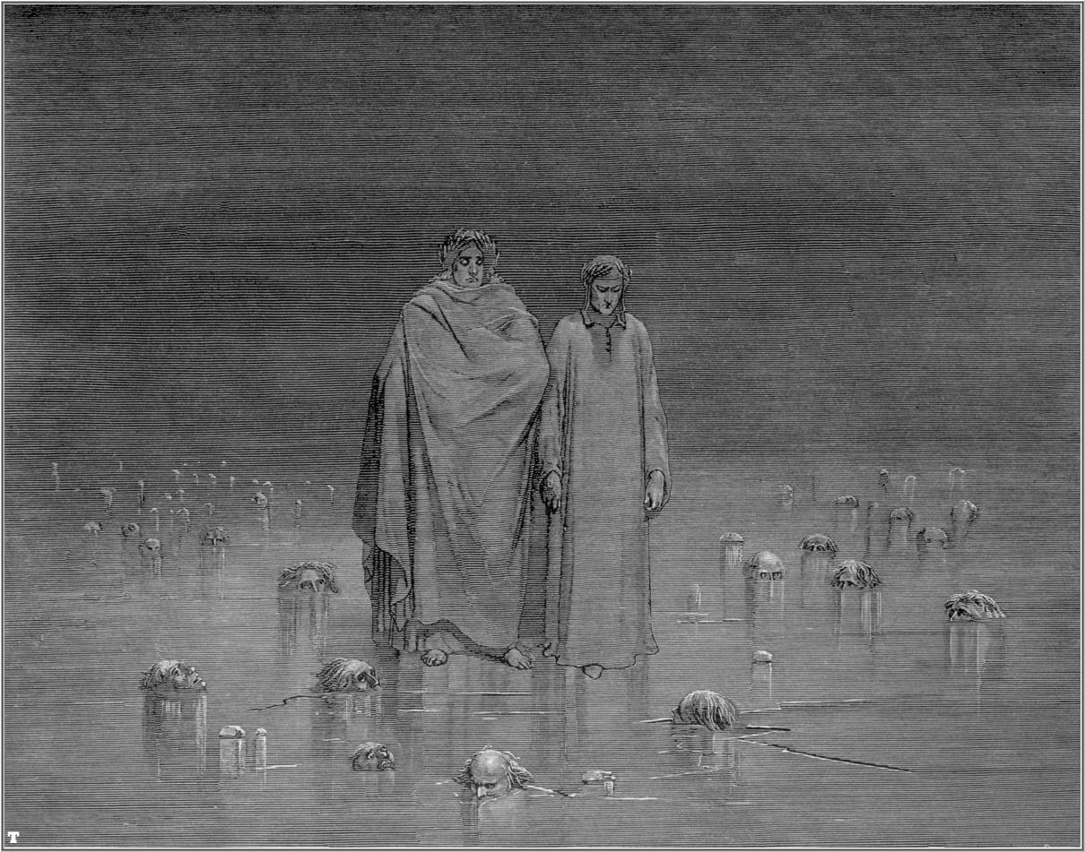
Circle Nine: Treachery
Round 1: named Caïna, after Cain, who killed his own brother; traitors to kindred
Punishment: immersed in the ice up to their chins with heads bent forward
Round 2: named Antenora, after Antenor of Troy, who betrayed his city to the Greeks; traitors to political entities
Punishment: immersed in the ice up to their chins
Round 3: named Ptolomaea, after Ptolemy, who invited father- and brothers-in-law to a banquet and then killed them; traitors to their guests
Punishment: lying on backs, fully covered in ice except their faces
Round 4: named Judecca, after Judas Iscariot, Biblical betrayer of Christ; traitors to their lords and benefactors
Punishment: completely covered in ice

Slide 13
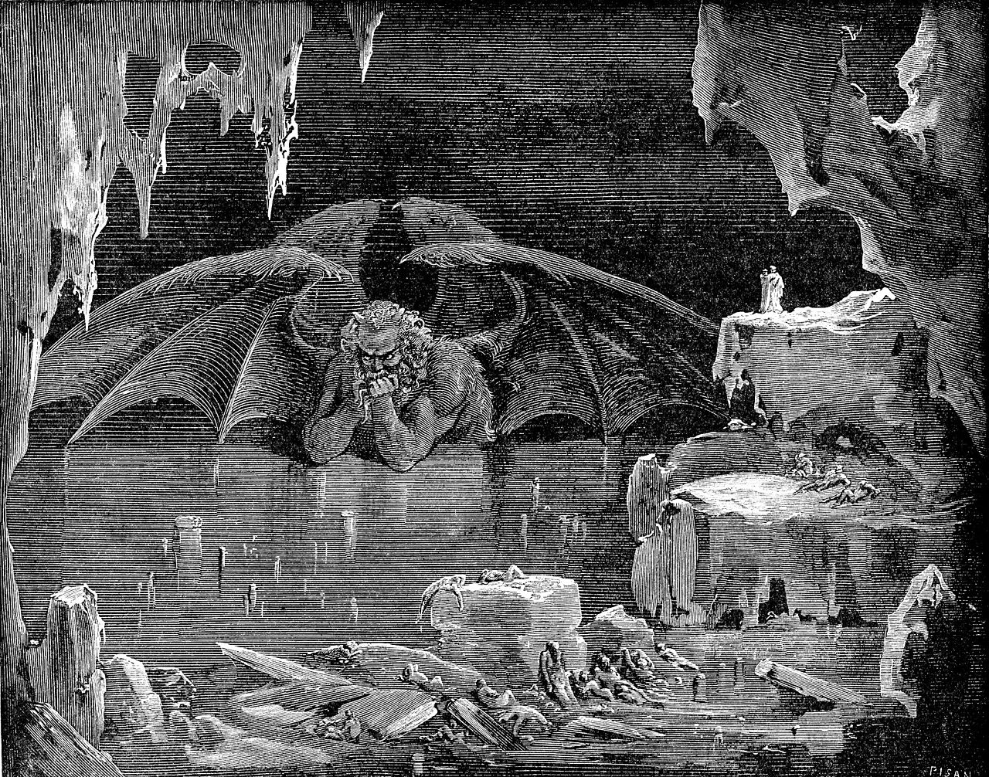
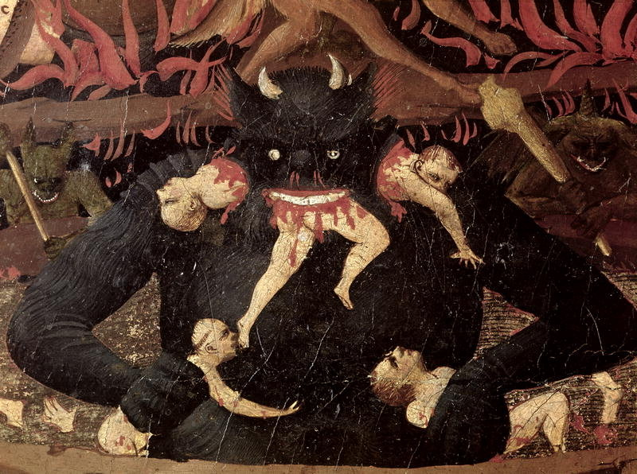
Circle Nine, Center of Earth: Satan
Satan, half submerged in ice, gnaws on Brutus, Cassius, and Judas with his three mouths

Slide 14
CANTO 34: COMPOUND FRAUD,
TREACHEROUS TO THEIR MASTERS, AND SATAN
Read the handout for Canto 34
Answer the following questions:
In Canto 34, why does Dante regard Judas, Brutus, and Cassius as the worst sinners of all? How does Judas’s sin differ from that of Brutus and Cassius?
In what way could Satan’s three faces be explained as symbols?

Slide 15
EXTENSION QUESTIONS:
Dante ranks human sins by his placement of different sinner in Hell. Does their punishment fit their crimes? Explain.
Honors:
What importance does Dante place on reason? What generalization can you make about Dante’s view of reason? Use evidence in the poem to make your generalization.
In his introduction to the Inferno, Archibald T. MacAllister states that Dante believed “that the mind must be moved in order to grasp what the senses present to it; therefore he combines sight, sound, hearing, smell and touch with fear, pity, anger, horror and other appropriate emotions to involve his reader to the point of seeming actually to experience his situations and not merely to read about them.” Do you agree that Dante’s use of images effectively draws readers into his story and makes them feel strong emotions? Explain, using specific examples from the selection.

Slide 16
PURGATORIO

Slide 17
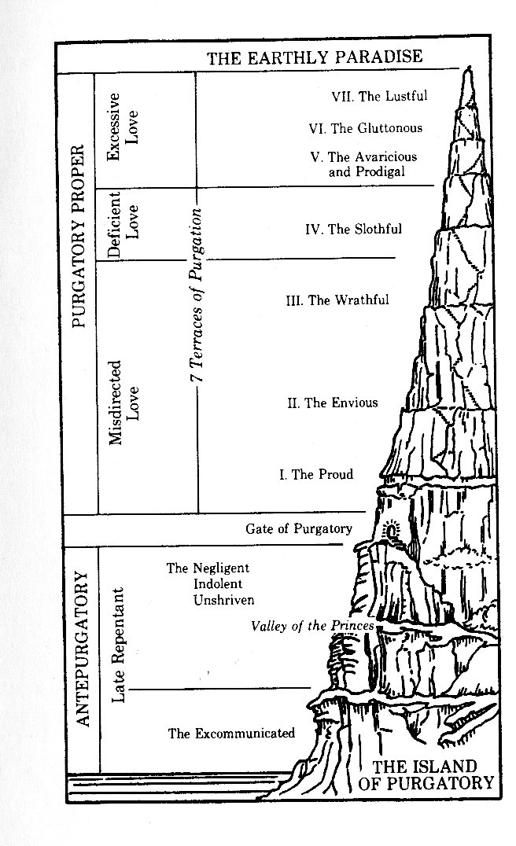
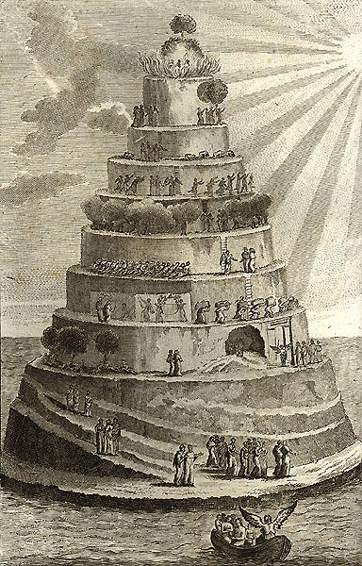

Slide 18
sectioned into seven layered parts on a mountain (seven deadly sins)
directly opposite of Inferno
composed of rock that shifted due to Satan’s fall
souls in Purgatorio have ability to move up into Paradiso through penitence
Purgatorio is separated into three major sections (Ante-Purgatorio, Purgatorio Proper, and The Earthly Paradise), each being separated into further sections to differentiate the sins of the spirits. When the sun sets, the spirits aren’t allowed to try to further climb the mountain.

Slide 19
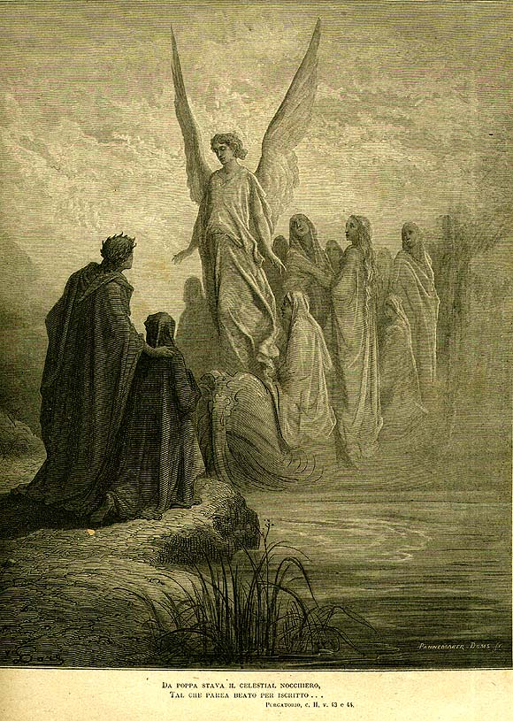
Ante-Purgatorio:
The Excommunicated: these spirits
were too stubborn to obey authority
(the Church); they must stay put thirty
times longer than the amount of time they went against the Church
The Late Repentant: these spirits were
either too lazy to repent or tried to repent at the last second without proper rites; they must stay put the same amount of time they were alive

Slide 20
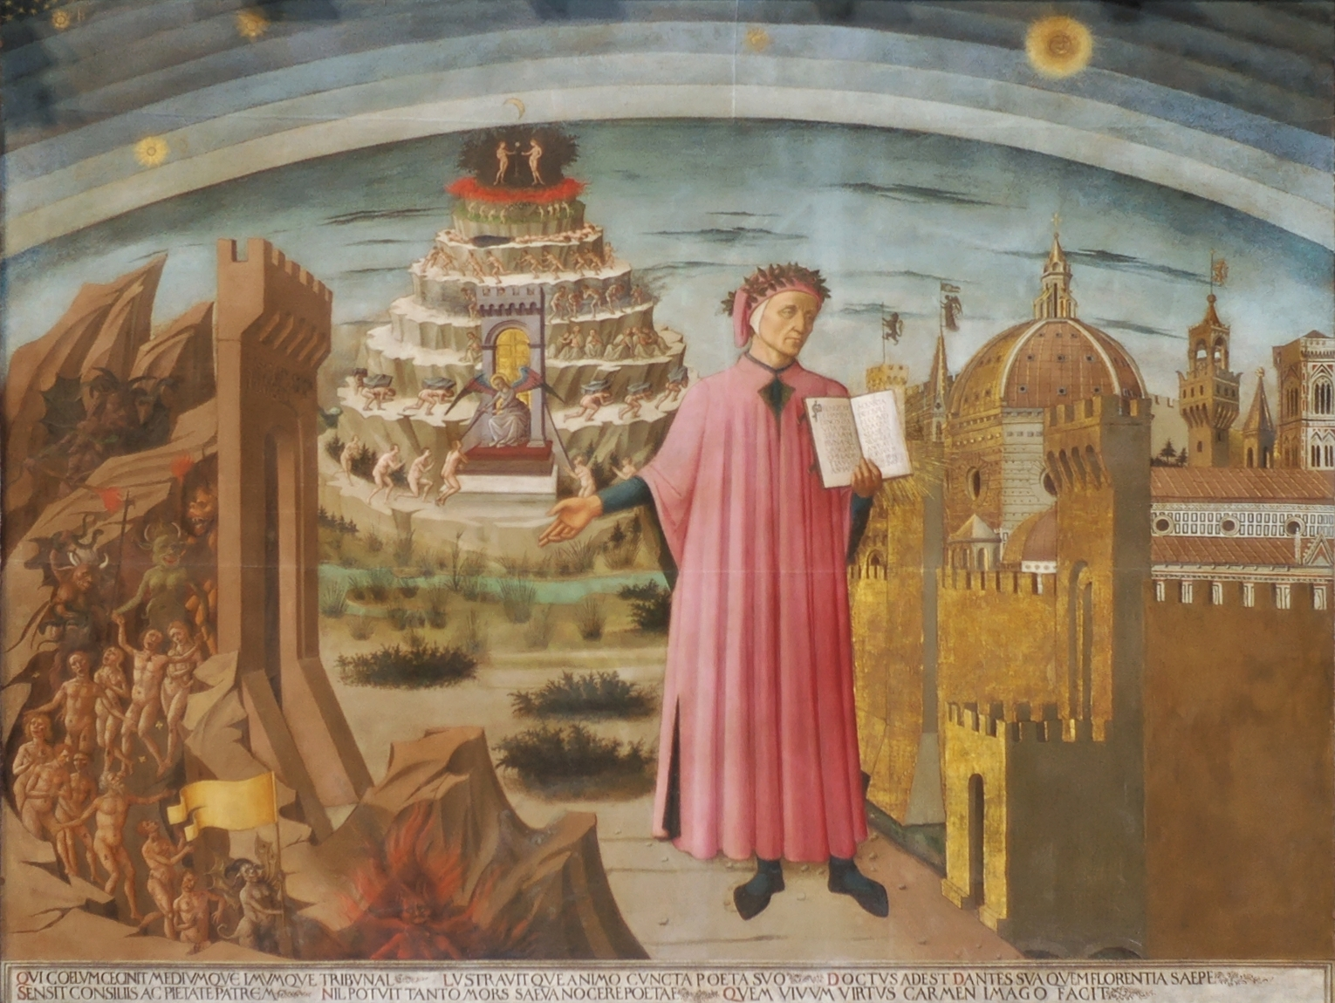
These seven deadly sins are all based on love (unnatural, inferior, or excessive). They can leave ONLY when they have completely repented.
Purgatorio Proper:
First Terrace: The Proud (opposing virtue is Humility)
These sinners carry large stones on their backs,
forcing them to hunch over (popular sinners/sins: Satan, the Tower of Babel, Arachne, and King Saul)
Second Terrace: The Envious (opposing virtue is
Generosity)
These sinners are cloaked and have their eyes sewn shut (popular sinner: Cain)
Third Terrace: The Wrathful (opposing virtue is
Meekness)
These sinners walk around in thick, pungent smoke (popular sinner: Haman)
The Gate of Purgatorio Proper

Slide 21
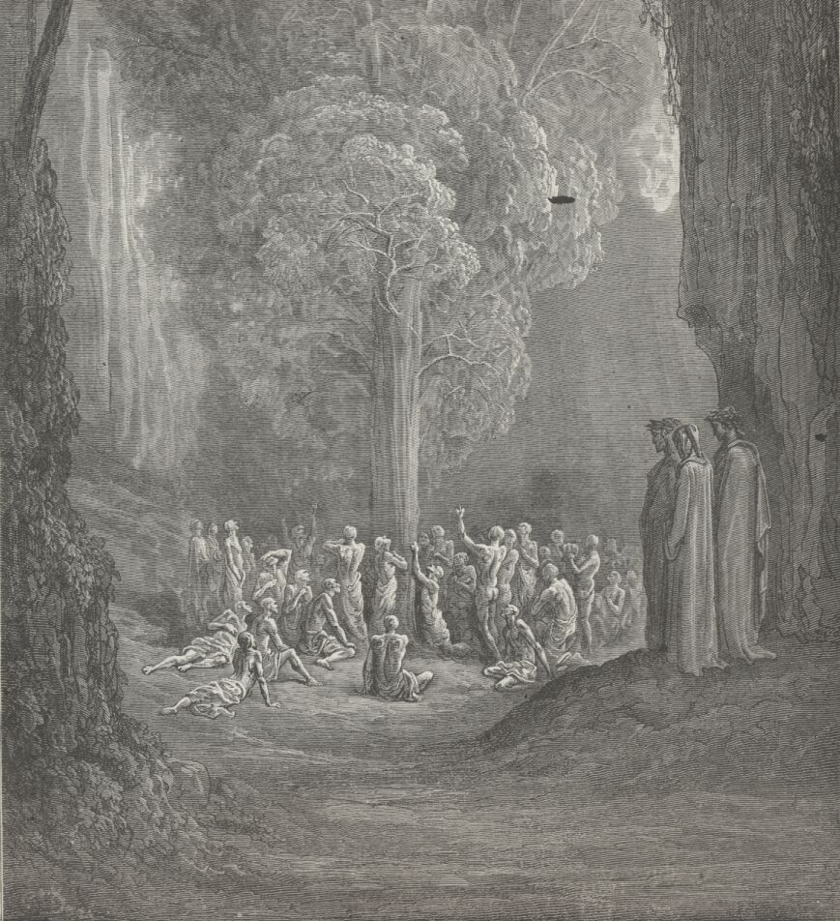
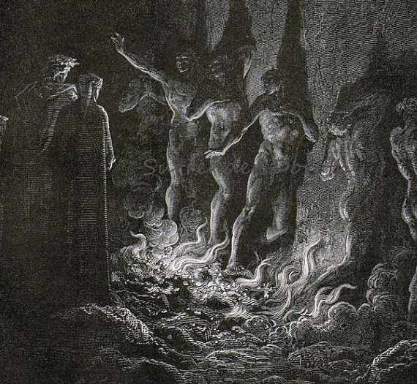
Fourth Terrace: The Slothful (opposing virtue is Zeal)
These sinners are forced to do pointless activities (no popular
sinners because they are too busy with their pointless activities to
talk to Dante)
Fifth Terrace: The Greedy (opposing virtue is Charity)
These sinners lie face-down on the ground and cannot move
Sixth Terrace: The Gluttonous (opposing virtue is Self-Restraint)
These sinners are unable to reach the fruit of a tree just out of reach
(sound familiar?) (popular sinners: drunken Centaurs)
Seventh Terrace: The Lustful (opposing virtue is Chastity)
These sinners walk through
flames crying out examples of
lust and trying to hug each other (popular examples: that daughter of Helios who slept with a bull, Sodom and Gomorrah)

Slide 22
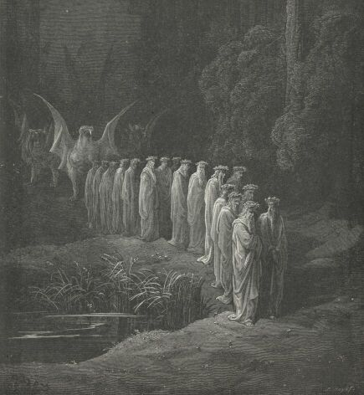
The Earthly Paradise (A.K.A. Garden of Eden):
Dante hears the most beautiful music and sees seven floating candles. Behind them, he sees a processional of allegorical symbols (allegory “inception” here):
twenty-four old men with lilies draped over their heads, representing the 24 books of the Hebrew Bible
four animals with six wings each full of eyes (like Argus), representing the four Evangelists
a two-wheeled chariot pulling Beatrice (yay!!) toward Dante, representing the divinity of Christ
a griffin (pulling the previous chariot), representing the humanity of Christ (together, they represent the joining of these two)
three women (shining red, green, and white), representing the three theological virtues: Love, Hope, and Faith
four other women dressed in purple, representing the four cardinal virtues: Prudence, Justice, Temperance, and Fortitude
two old men (one bearing a sword), representing the Acts of the Apostles and the Pauline epistles
four humble-looking people, representing the general epistles
a man at the end, who looked wise, representing the Book of Revelation
Dante has a super emotional discussion about his faith with Beatrice, after which he passes through the river Lethe, washing away his sins. He then drinks from the river Eunoë, which returns his good memories.
Notes:
Does all of this need to be here, as cool as it is?

Slide 23
PARADISO

Slide 24
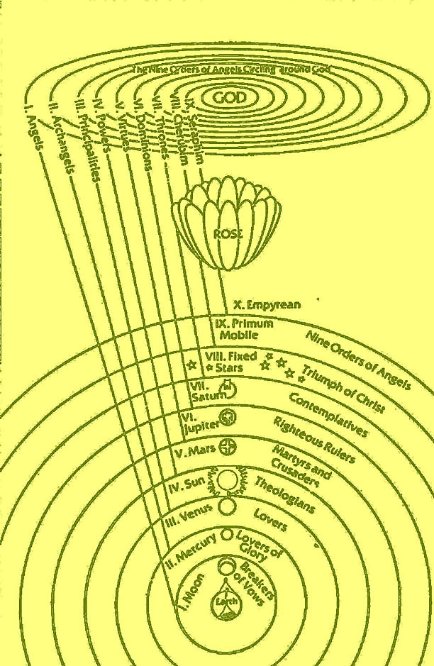
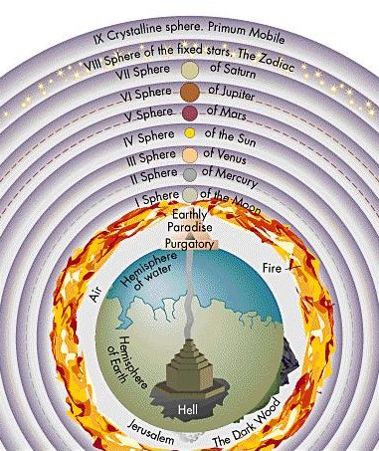

Slide 25
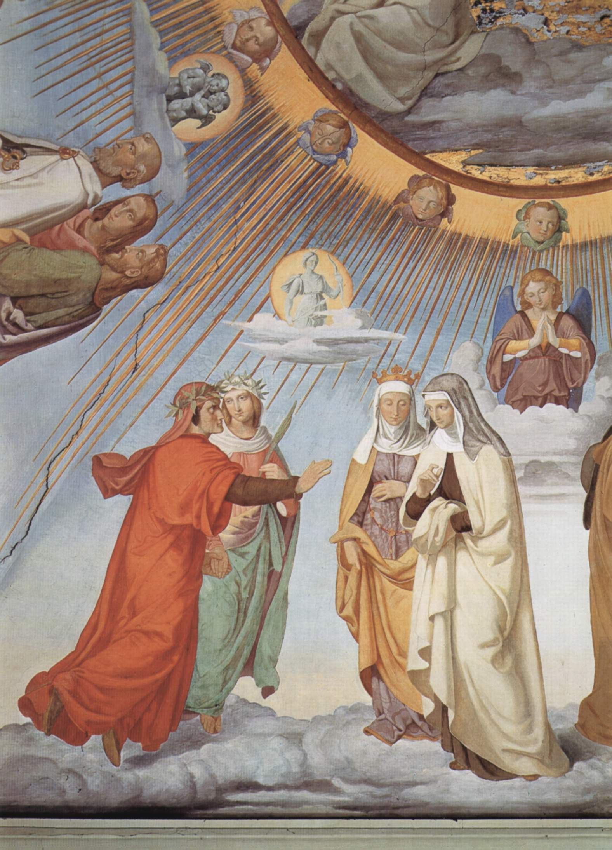
Everyone here technically lives with God in Empyrean, but in order to make the journey more understandable for us (and himself), Dante describes the souls he meets in different spheres. The spirits all recognize that their placement is fair because they are at least in the realm of God.
The first section holds those who were blessed, good people but weren’t as perfect as their
later counterparts.
Circle 1: Sphere of the Moon
The Inconstant (fickle): slowest moving sphere for those who were
forced to abandoned their vows to God
Circle 2: Sphere of Mercury
The Ambitious: associated with the Messenger God
(Mercury/Hermes), and a planet often blocked by the Sun; these
spirits desired glory (the wrong kind of justice); Beatrice explains the
crucifixion of Christ and the atonement of Man
Circle 3: Sphere of Venus
The Lovers: associated with the Goddess of Love
(Venus/Aphrodite), these spirits showed inferior/insufficient forms
of romantic love (as opposed to Lust - what we see in Inferno and
Purgatorio)

Slide 26
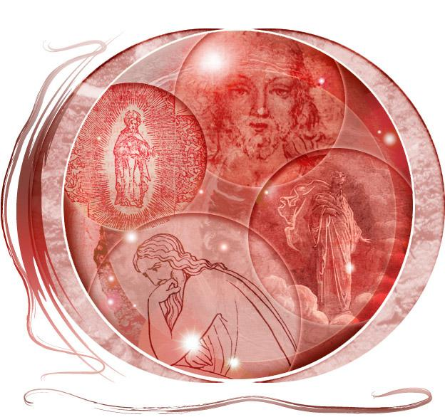
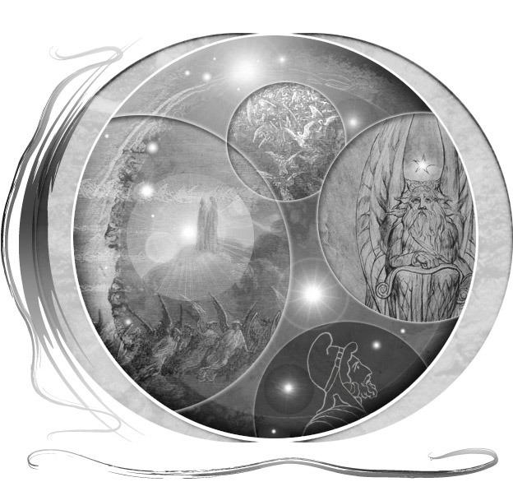
The second section holds those who lived lives according to the four cardinal virtues: Wisdom, Justice, Self-Restraint, and Courage.
Circle 4: Sphere of the Sun
The Wise: like the brightness of the sun, these spirits brought wisdom to the
world (philosophers, theologians and a king - including, Thomas Aquinas and
King Solomon)
Circle 5: Sphere of Mars
The Warriors of Faith: associated with the God of War (Mars/Ares), these
spirits gave their lives and all their strength/courage for God (popular spirits
include Joshua, Charlemagne, and one of Dante’s ancestors)
Circle 6: Sphere of Jupiter
The Just Rulers: associated with the King of Gods (Jupiter/Zeus), these
spirits were fair, strong rulers (popular spirits include David and Constantine)
Circle 7: Sphere of Saturn
The Contemplatives: associated with the leader of the Titans
(Saturn/Cronus), these spirits dedicated their lives to prayer

Slide 27
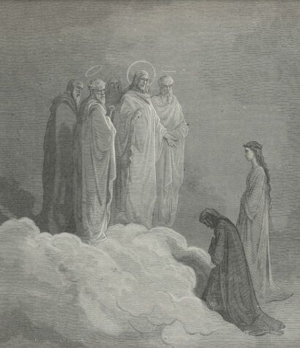
The third section holds the spirits closest to God, including God Himself.
Circle 8: Sphere of the Fixed Stars, The Zodiac
Faith, Hope, and Love: Dante
sees the Virgin Mary, St. Peter, St. James, and St. John; Peter questions Dante’s faith, James
questions Dante’s hope, and John questions Dante’s love

Slide 28
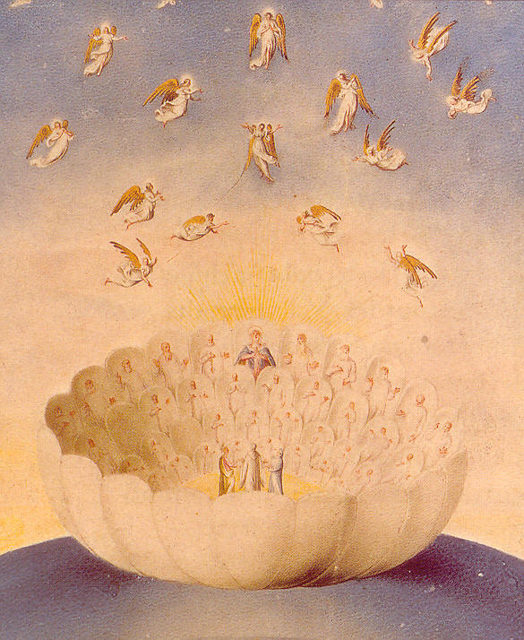
Circle 9: Crystalline Sphere, Primum Mobile (“first mover” - previous spheres
moved by God)
Nine rings of angels
Empyrean: God’s location
The rose of the faithful: Dante sees all the aforementioned spirits and angels residing within; apparition of God as three layered circles (representing the Trinity); angels fly around the white rose “like a troop of bees”

