Slide 1
Creating an Outline
Dos and Don’ts for organizing your thoughts

Slide 2
Why Outline?
Logical bridge between research and final paper
Way to organize the ideas that will eventually go into your paper
List major ideas/topics you will cover followed by subtopics that relate to each major idea
Shows relationships/order of information
Helps keep track of researched information
Keeps you effectively on point
Defines boundaries (when moving from one topic to another)

Slide 3
An outline should:
Be organized
Be logical
Help you organize your thoughts
Make sense for YOU
The presented sample outline is not set in stone
Add more elaboration or details if necessary

Slide 4
An outline should:
Be specific
Don’t just say “Elaborate here.”
Include citations with quoted/paraphrased material (this helps when you’re actually writing the paper – all the information is already there!)
Pull the information from your source/notes sheets

Slide 5
An outline should:
Have more than one item per heading
If you have a I, you should also have a II
If you have an A, you should also have a B
If you have a 1, you should also have a 2
Introduction
Hook/opening comments
Background information
Thesis
Main Point 1:
Detail:
Elaboration
Elaboration
Detail
Elaboration
Elaboration
Main Point 2
Detail
Elaboration
Elaboration
Detail
Elaboration
Elaboration
For example:

Slide 6
An outline should:
Be parallel
The significance of info in A should be equally as important as the info in B.
Same with subheadings and subordinate information
Broadest information in first heading, narrow with each subsequent heading
For example:
Broader idea
More specific detail
Super specific evidence

Slide 7
NO!!!!!
YES!!!!!
The armed services
The Army
The Navy
The Marines
The Air Force
The armed services
The Army
The Navy
The Marines
The Air Force

Slide 8
An outline should:
Be a detailed list of information that will most likely be in your paper
Include your complete quotes or paraphrases/facts from the source sheets
Include in-text citations with the quotes or paraphrases/facts
Have thesis and topic sentences in complete sentences
Use correct MLA formatting (remember your Versal course!)
Include a separate completed/updated Works Cited page at the end of sources you actually used

Slide 9
An outline should NOT:
Be longer than your final paper
Be in all complete sentences (that’s basically your paper…)
Be a list of one-word items (elaborate when necessary)
Be a random list of stuff you took from research
Contain emojis or slang (this is a formally written assignment)
Be a waste of your or my time

Slide 10
For example:
NO!!!!!
YES!!!!!
Main Point: Mengele’s early life did not teach him any particular respect or compassion for others.
He had a forceful mother, who greatly impacted the way he approached others in the future.
His mother often openly criticized members of the family, including his father, in public, proving to be the strict disciplinarian of the family.
She forced all her children to be Catholic, preventing them from making any choice or decision for themselves.
Mengele even described his mother as “not capable of loving (“Josef Mengele”).
When he was younger, Mengele spent most of his time with his nanny, Monika.
She taught him from an early age that non-Catholics were damned, reinforcing the idea passed down from Mengele’s mother.
The nanny did not allow Mengele - “a curious youth – to question the Catholic faith” (Cefrey).
Main Point: Mengele’s early life did not teach him any particular respect or compassion for others.
Forceful mother
Openly criticized members of family
Forced children to be Catholic
Described as “not capable of loving” (“Josef Mengele”)
Nanny, Monika
Non-Catholics were damned
Did not allow Mengele – “a curious youth – to question the Catholic faith” (Cefrey)

Slide 11
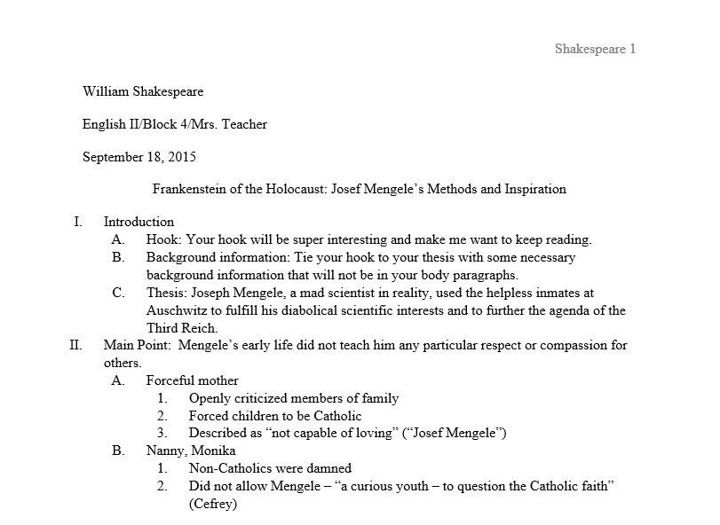
Outline Sample
Header with Last Name and page #
Double-spaced heading
Unique, centered title
12-point, Times New Roman font
Appropriately detailed information
One-inch margins
Included citations
Formal language
Thesis and topic sentence in complete sentences

