Slide 1
The Trojan War

Slide 2
I. The Wedding
King Peleus and nymph Thetis
Eris (evil) is not invited
She crashes with a golden apple
Three goddesses claim it:
Hera
Athena
Aphrodite
Zeus asked to judge: no way, Jose!
Sends them to Mt. Ida for Paris to judge

Slide 3
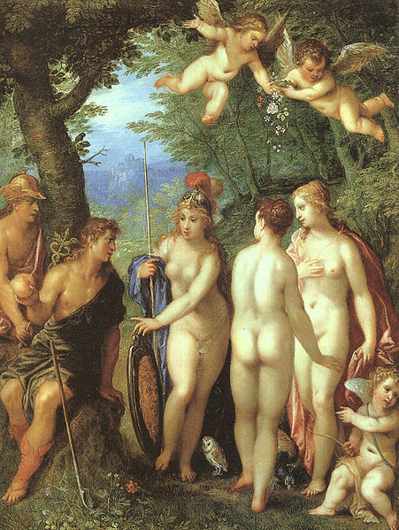
Paris Has to Choose
B. The Judgment of Paris
1. Prince of Troy, Priam’s son
2. Yet again, a prophecy of destruction
3. Lives with nymph, Oenone (ee-no-nee)
4. The 3 goddesses arrive and offer bribes
a. Athena: make him lord of Europe and Asia
b. Hera: give him victory over Greece
c. Aphrodite: give him most beautiful woman in the world
5. Paris is weak and a coward: he chooses……?

Slide 4
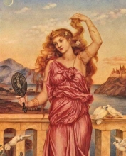
The Marriage/Kidnapping of Helen
C. The Capture of Helen
1. Helen is the most beautiful
a. Daughter of Zeus and Leda; sister of Castor and Pollux
b. So beautiful Theseus tried to kidnap her as a child
c. “Dad,” King Tyndareus of Sparta, comes up with a plan
d. Suitors, unite!
e. Menelaus is chosen
2. Paris goes to visit Sparta…
a. Laws of hospitality
b. Menelaus trusts Paris, but…….
c. Paris runs away with Helen

Slide 5
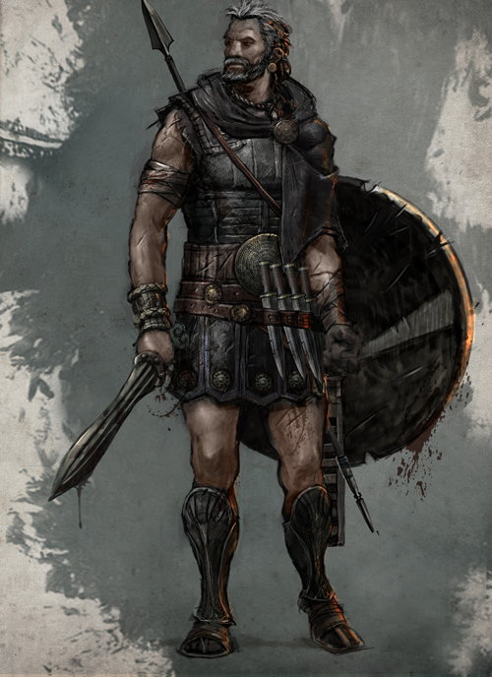
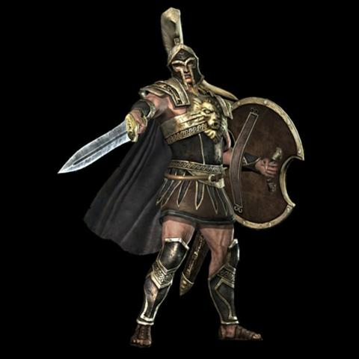
II. Preparations for War
A.All but two:
1. Odysseus, King of Ithaca
a.doesn’t want to leave his family
b.Pretends to be crazy
c.Palemedes tests that theory
d.It’s off to the army for him!
2. Achilles
a. Mama knows he’ll die if he goes to Troy
b.Thetis hides him at the court of Lycomedes, disguising him as a girl
a.Odysseus knows better
b.Achilles is revealed
c.It’s off to the army for him too!

Slide 6
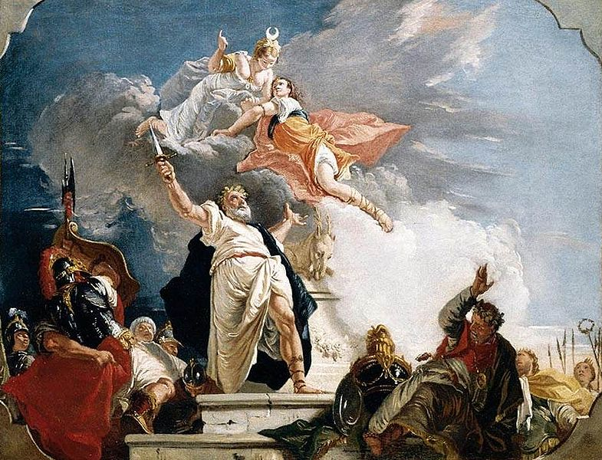
“”Was this the face that launched a thousand ships?” Christopher Marlowe
B.1,000 ships set out for war
C. Trouble at Aulis
1. Artemis is super mad: someone killed a sacred deer.
2. Must sacrifice Iphigenia
3. Agamemnon reluctantly agrees
a.Fake wedding to Achilles
b.Iphigenia arrives with her wedding clothes and is killed
c.Clytemnestra holds a long grudge
4. Wind stops, ships sail

Slide 7
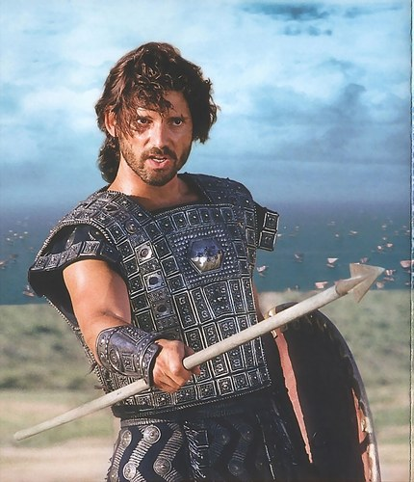
III. The War: Leaders of Troy
A. Royal Family of Troy
1.King: Priam
a. old
b. 50 sons
2.Queen: Hecuba
a. not the mother of all 50
3.Paris
a. we’ve met him; not impressed
4.Hector
a. now we’re impressed
b. the greatest warrior in Troy
c. Priam’s noblest son
d. The only prince of Troy NOT to
develop the hots for Helen
e. The only one to be nice to Helen when
everyone is tired of a10 year war
5.Andromache
a. Hector’s wife
6.Cassandra
a. Priam’s daughter, loved by Apollo, gave her the gift of prophecy
b. rejected the god, who cursed her: no one would ever believe her truths

Slide 8
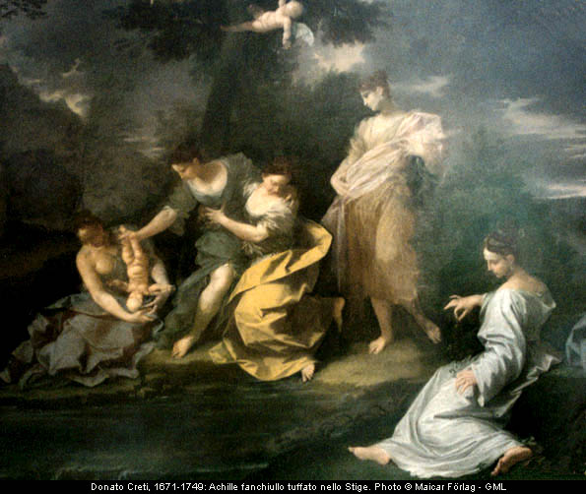
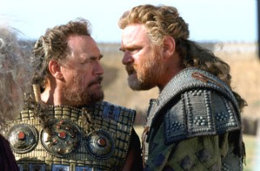
Leaders for the Greeks
B. The best of the Greeks
1.Achilles
a. immortal except his heel
b. golden armor
c. greatest Greek warrior
2.Agamemnon
a. King of Mycenae
b. Leader of the Greeks
c. bossy, proud, unreasonable
3. Menelaus
a. King of Sparta
b. Helen’s husband
c. Agamemnon’s brother

Slide 9
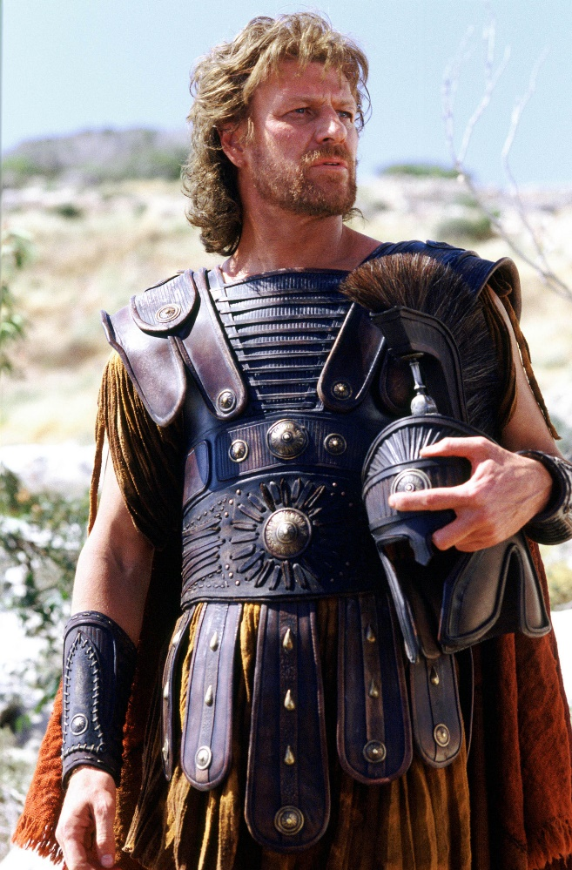
Leaders for the Greeks, contd.
4. Odysseus
a. King of Ithaca
b. Crafty, the smartest hero
5.Ajax
a. crazy strong
b. fiercest warrior
6. Protesilaus
a. first to land on Troy
b. Why is this a big deal?
c. After his death
C. Two greatest warriors knew they would die

Slide 10
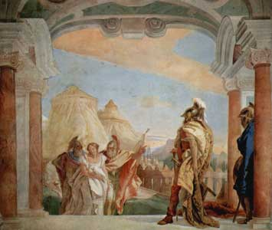
Woman Trouble
D. The Women of the Trojan War
1. Achilles and Agamemnon butt heads over captive women:
2. Chryseis
a. Agamemnon captured her
b. Her dad is a priest of Apollo, and he begs her release
c. Agamemnon refuses
d. Calchas, a soothsayer says:
Chryseis must be returned
g. Agamemnon’s pride and anger
3.Briseis
a. Achilles captured her
b. Agamemnon takes her as retribution
c. Achilles pouts and stops fighting
d. Greeks begin to lose the war

Slide 11
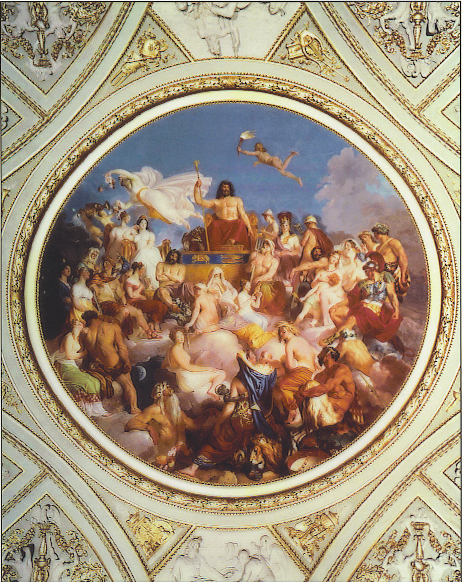
The Super Bowl of the Gods
E. The gods take sides
1. For the Trojans:
a. Aphrodite: for Paris
b. Ares: always with Aphrodite
c. Apollo: for Hector, angry over Chryseis
d. Artemis: always with Apollo
e. Zeus: supposed to be neutral ,but
favors Troy anyway
2. For the Greeks:
a. Hera: woman scorned (Zeus)
b. Athena: same condition
c. Poseidon: Greeks are a seagoing culture
3. Thetis pushes Zeus to help Troy
a. Greeks can’t win without Achilles
b. Zeus sends Agamemnon a lying dream, telling him to attack
c. fierce battle ensues

Slide 12
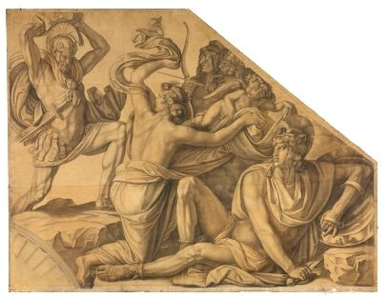
Fighting over Helen
F. Menelaus v. Paris
1.Honor dictates no interference
2. Swordfighting
3. Menelaus’ sword breaks for no reason
4. Menelaus attacks Paris
5. Aphrodite intervenes
6. Menelaus hunts Paris among the Trojans
7. Agamemnon says Menelaus won, Helen should be returned
8. Athena tricks a Trojan into breaking truce
G. Aphrodite and Ares are humiliated
1. Aeneas, Aphrodite’s son
injured
2. Hera chases Ares away

Slide 13
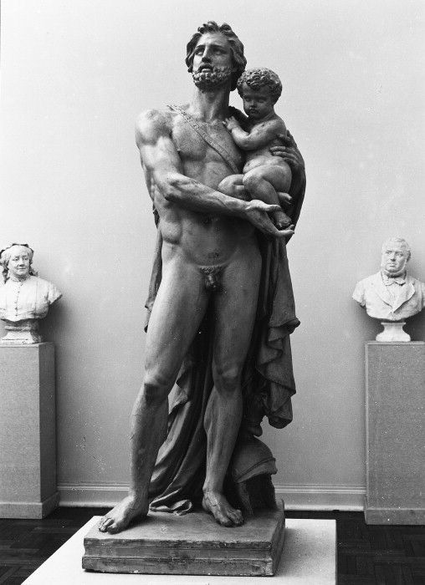
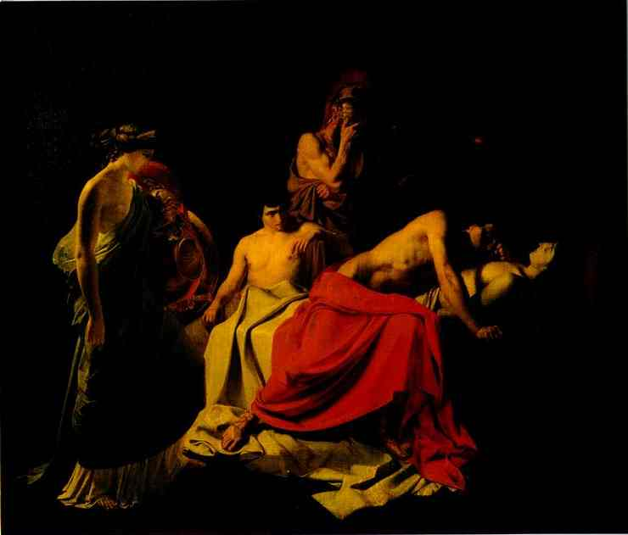
The Death of Patroclus
H. Hector prepares for his last day
1. Knows he’s going to die
2. Wants to see wife and baby son,
Astyanax
3. Says farewell
4. Tenderest moment in the Iliad
I. Greeks lose ground
1. Need Achilles
a.Agamemnon offers Briseis
b. Achilles stubborn; will return for nothing
2. Achilles’s BFF Patroclus takes his armor, goes into battle
a.Trojans intimidated
b. Hector kills Patroclus
c. Achilles flips out

Slide 14
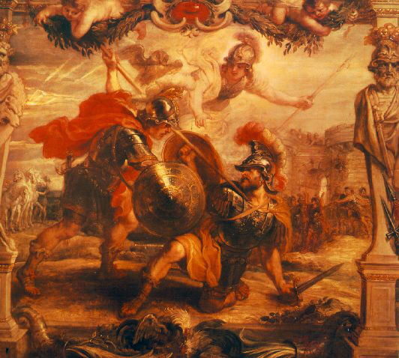
Hector’s Last Stand
J. Achilles v. Hector
1. Thetis gives Achilles new,
magical armor
2. Hector wears armor from
Patroclus’s body
3. Hector runs from Achilles; can’t
catch each other
4. Fate isn’t with Hector
a. Helpful Apollo has to back off; fate is against Hector
5. Hector stops, seeing Athena
disguised as dead brother
6. Faces Achilles, helped by
Athena
7. Achilles kills Hector through
opening in armor

Slide 15
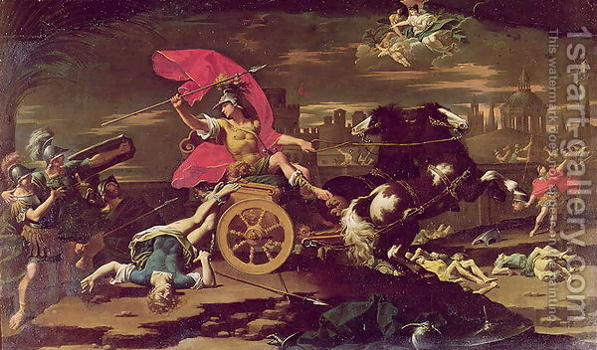
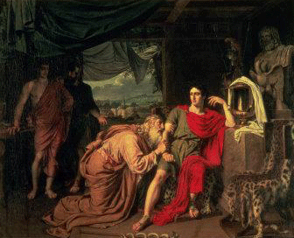
The Desecration of Hector
K. Achilles breaks big rules
1.Hector begs to be returned
to parents; Achilles refuses
2. Achilles ties Hector’s body
(by the ankles) to his
chariot & drags it around
Troy
3.Most gods are massively
displeased
4. Priam begs Achilles for
son’s body
5. Achilles is touched, agrees
6. Nine days truce for funeral
rites

Slide 16
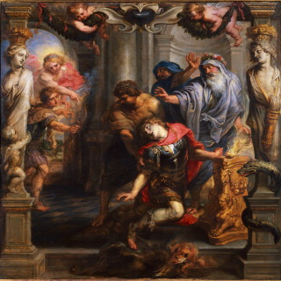
IV. The Fall of Troy
A. Achilles’s last battle
1. kills Memnon of Ethiopia
2. drives Trojans back
3. Paris shoots Achilles’s heel—
kills him
B. The death of Ajax
1. Two heroes are nominated to
receive the arms of Achilles:
Ajax and Odysseus
2. Odysseus wins—huge honor
3. Ajax disgraced, plans to kill
Agamemnon & Menelaus for
turning vote against him
4. Ajax attacks at night; Athena
strikes him mad—thinks
sheep are Greeks; ram is
Odysseus
5. Humiliated, kills himself

Slide 17
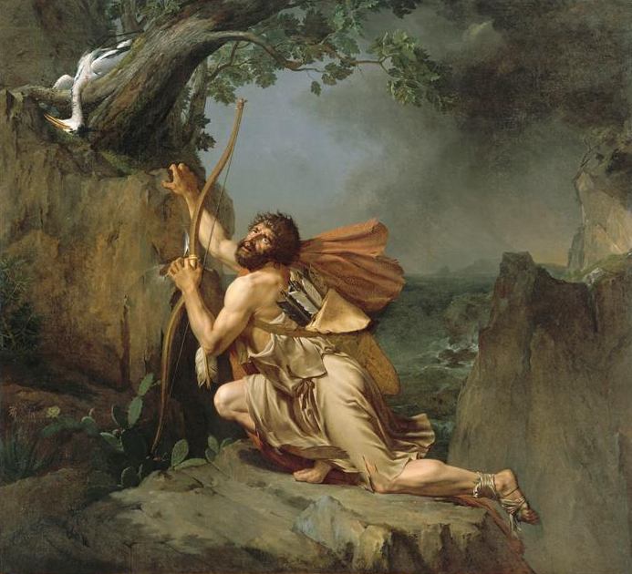
Philoctetes
C. The arms of Hercules
1. Greeks find prophet, Helenus
a. Can’t win unless they kill Paris
b. Only the bow and arrows of
Hercules can
2. Philoctetes has them
a. Bitten by serpent during trip;
wound won’t heal
b. The Greeks left him
3. Odysseus goes for the weapons
a. First, he steals them
b. Guilt: he gets Philoctetes, takes him
to Greek doctor
4. Healed, Philoctetes joins battle, kills Paris
D. Greeks have to steal the Palladium (sacred image of Athena) in order to win—Odysseus is their man

Slide 18
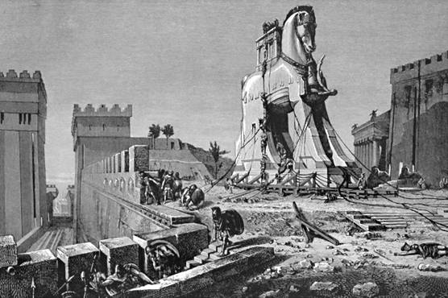
How to Trick a Trojan
E. The Trojan Horse
1. Greeks have to get into Troy to win
2. Odysseus thinks up the hollowTrojan horse
3. Remaining Greeks pretend to sail away
a. Sinon left on beach with story to get horse in
4. Trojans thrilled, rush to see Sinon
a. He cries, renounces his Greekhood
b. He says Athena was angry over the Palladium
& demanded a sacrifice
c. Escaped and hid
d. Horse as offering to Athena
e. Trojans fall for it
5. Warning! Warning!
a. Cassandra says no!—no one
believes her
b. Laocoon, a priest, says burn it—
Poseidon sends 2 serpents to crush Laocoon
and his sons
F. Trojans take horse in
1. At night whole Greek army sneaks in
2. Set Troy on fire
3. Greeks win

Slide 19
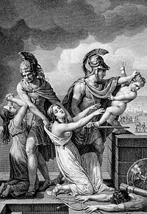
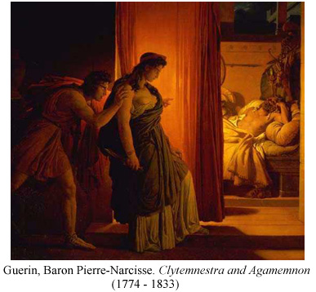
V. Where Are They Now?
A. Priam: spared by Achilles, but Neoptolemus (son) kills him
B. Hecuba: taken into slavery
C. Polyxena (Trojan princess): killed on Achilles’s grave
D. Aeneas
1. fights Greeks as long as possible
2. escapes Troy (with mom Aphrodite’s help), saving his father & son, but not his wife
3. Virgil’s Aeneid, which gave Rome a cool history
E. Helen
1. Aphrodite helps her out of the city
2. She goes back to Menelaus, and they live happily ever after
F. Andromache
1. slave to a Greek warrior
2. baby taken and thrown from walls of the city, like all other babies
G. Cassandra
1. Agamemnon’s captive
2. Warns Agamemnon of impending doom (ignored)
3. Clytemnestra is waiting (with a lover, Aegisthus) and murders both

