Slide 1
ARCHETYPES
archetype
archetype
archetype
literature
literature
images, symbols, characters, patterns, and settings that happen in all kinds of literature to create unity

Slide 2
What are common characteristics of archetypes?
Build commonality with all humanity
Can be subconscious
Universal, understood by everyone
Recurring, change with modern times, relate to the past in order to find meaning in a contemporary world
Literature may change, but the archetypes generally don’t

Slide 3
ARCHETYPAL CHARACTERS

Slide 4
THE HERO
portrayed as “larger than life”
outstanding qualities and abilities
embodies the ideals of his/her culture and society
self-sacrificial
will endure separation and hardship for his/her people
must a pay a price to achieve goal
must go from “ordinary world” into the “unknown”; comes back changed
must return and spread new knowledge, but does not have to stay

Slide 5
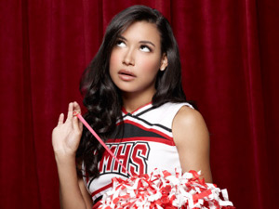
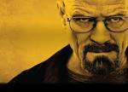
THE ANTI-HERO
reluctant to consider self capable of accomplishing goal
might be selfish, addicted, corrupt, sullen, or disaffected
believes “the ends justify the means”
typically transforms into a fuller, happier, or more complete person because of struggles
can sometimes die at the end, even while overcoming

Slide 6
THE VILLAIN
the “bad guy”
tends to have a negative effect on others
Usually involved in or devoted to wickedness or crime
Constitutes an important evil agency in the plot

Slide 7
THE WISE OLD MAN
Super smart philosopher with sound judgment
Sometimes bearded

Slide 8
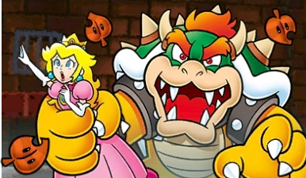
THE DAMSEL IN DISTRESS
usually a beautiful young woman placed in a dire predicament by a villain or monster
needs the hero to rescue her

Slide 9
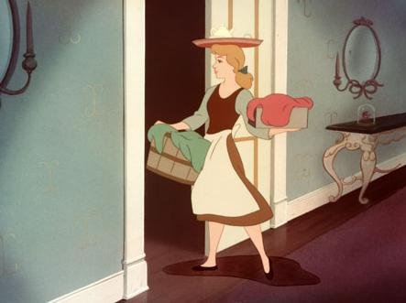
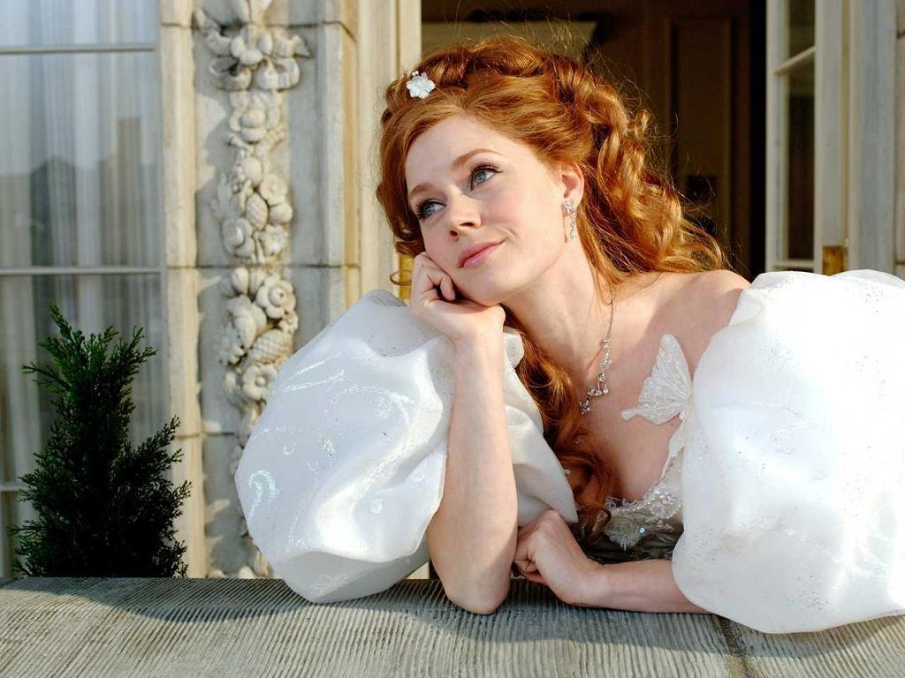
THE INNOCENT
promised that life need not be hard
naïve/inexperienced person exposed to the evil in the world
usually moves from innocence to experience and knowledge

Slide 10
EARTH MOTHER
provider: protecting, nurturing, sheltering, nourishing female character

Slide 11
THE TEMPTRESS
through her power and/or beauty, can render a strong man weak and a wise man foolish

Slide 12
SCAPEGOAT OR SACRIFICIAL VICTIM
One who suffers or is blamed unjustly so others may escape blame or punishment.

Slide 13
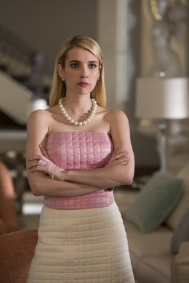
THE SHREW
a woman who is excessively unpleasant
prone to temper tantrums, emotional and psychological warfare, and abuse
will go to extreme measures to get her way
dominates her relationships, especially the one with her weaker willed husband

Slide 14
ARCHETYPAL SETTINGS

Slide 15
THE GARDEN
carefully planned and kept, restricted to certain vegetation, represents order

Slide 16
THE FOREST/
COUNTRYSIDE
Habitat of Mother Nature who keeps control
Fertility
Those who enter often lose their way
Opposite of the garden
Notes:
Into the Woods; Wild by Cheryl Strayed

Slide 17
THE TREE
Represents life and knowledge

Slide 18
MOUNTAINS/PEAKS
Highest peak is place to “see” far
Place to gain great insight

Slide 19
THE CAVE
Deep down where the character self-reflects
At the extreme may signify death

Slide 20
ISLANDS
small worlds unto themselves
represent isolation

Slide 21
ARCHETYPAL SYMBOLS

Slide 22
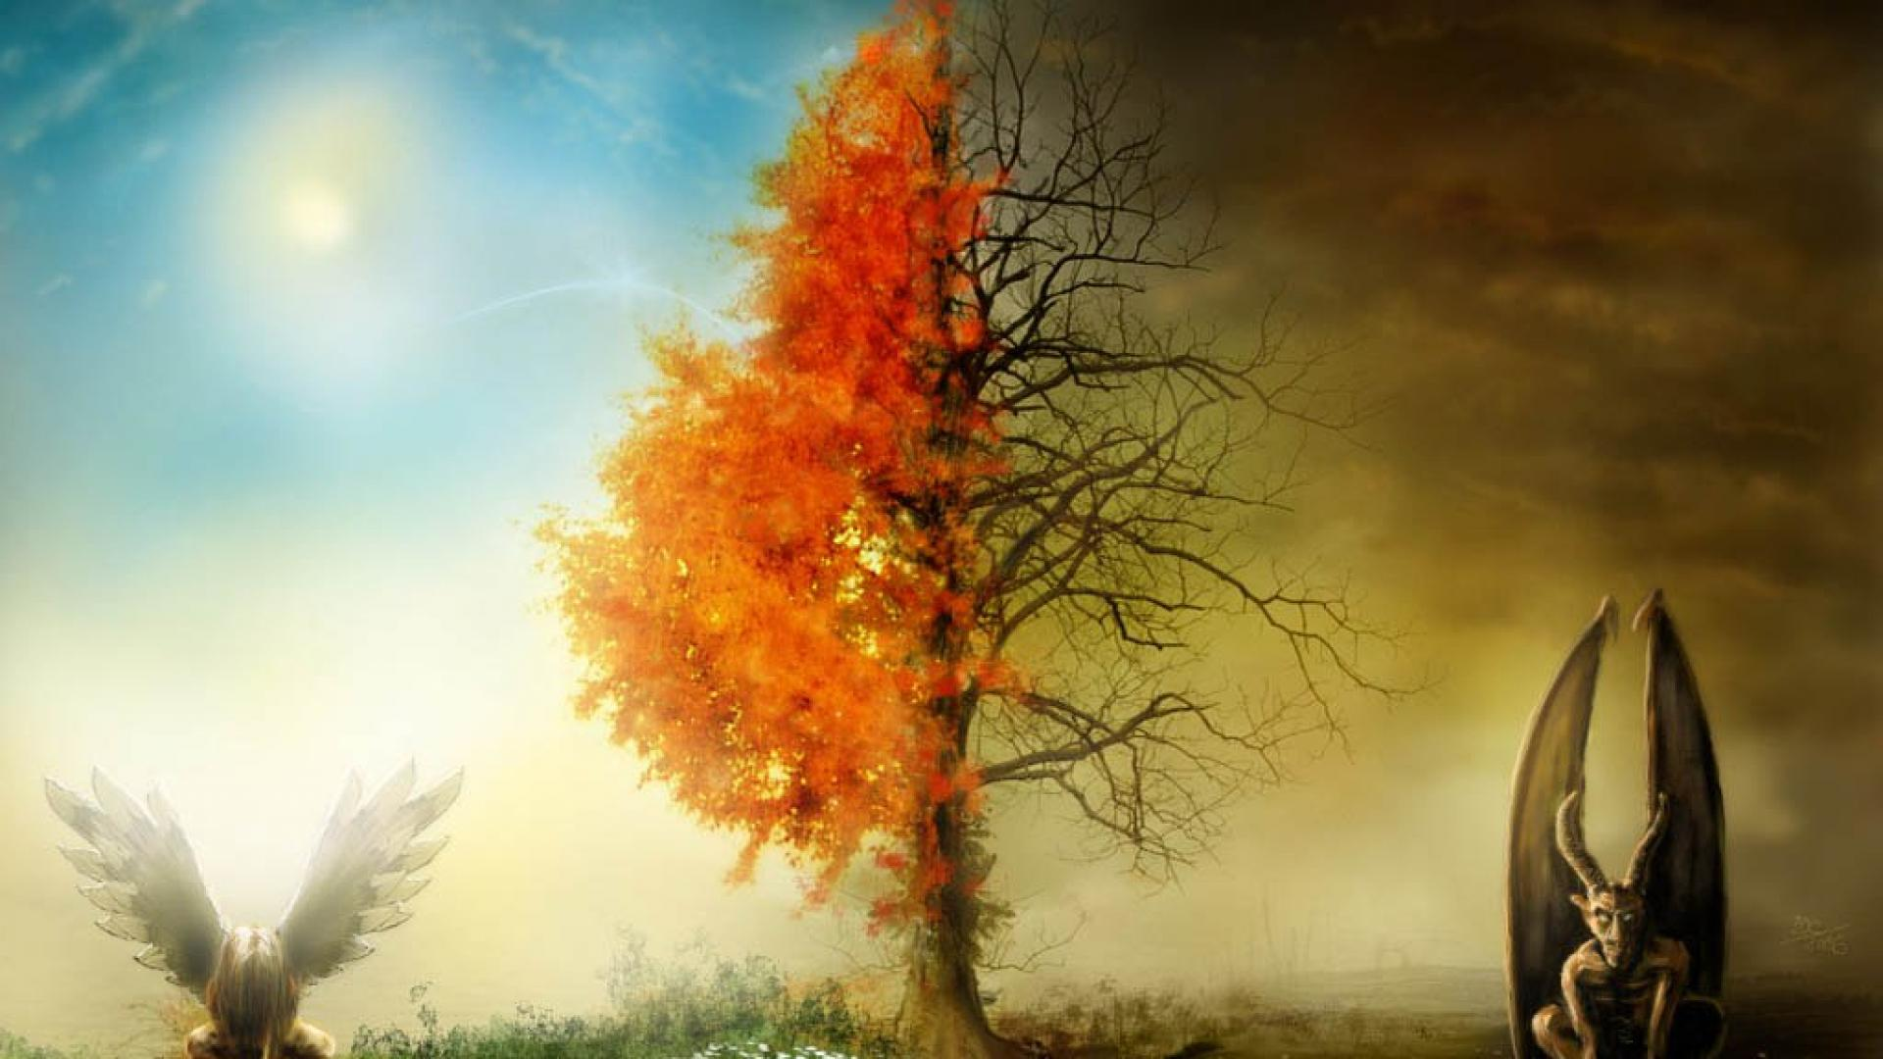
LIGHT VS. DARKNESS
Light usually suggests hope, renewal, or intellectual illumination
Darkness implies the unknown, ignorance or despair

Slide 23
SUPERNATURAL INTERVENTION
A god or supernatural/mysterious figure who intervenes for or sometimes against the hero

Slide 24
ARCHETYPAL SITUATIONS

Slide 25
THE TASK: DO SOMETHING!
to save the kingdom
to win the fair lady
to identify himself so he may reassume his rightful position
…the hero must perform a superhuman deed

Slide 26
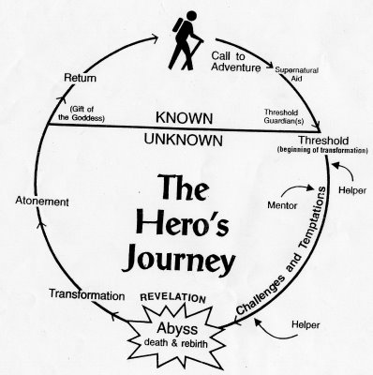
THE JOURNEY: LEARN SOMETHING!
The hero searches for some truth or information necessary to restore goodness to the kingdom.

Slide 27
ARCHETYPAL THEMES AND MOTIFS

Slide 28
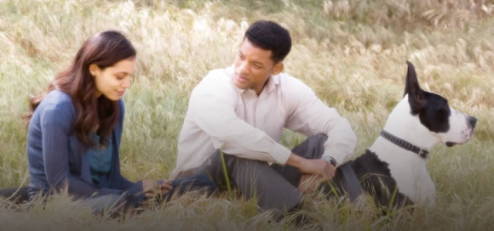
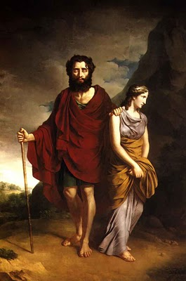
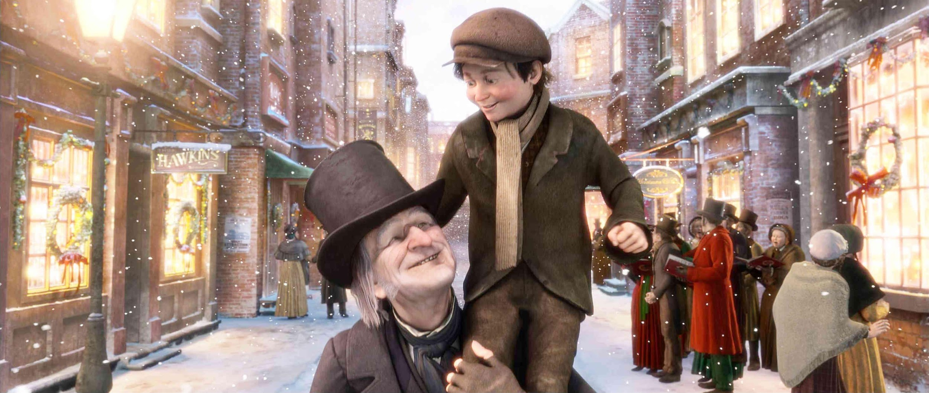
GUILT AND REDEMPTION
When a character feels bad and wants to atone for real or perceived sin
Requires some kind of heroic act or sacrifice

Slide 29
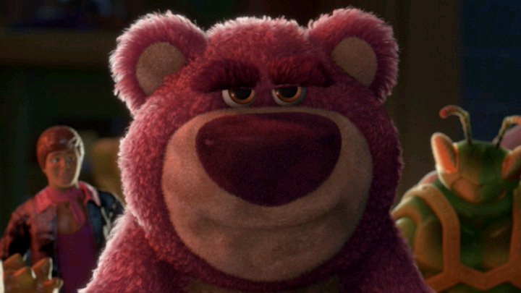
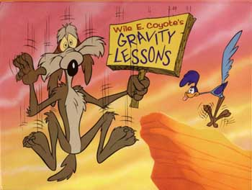
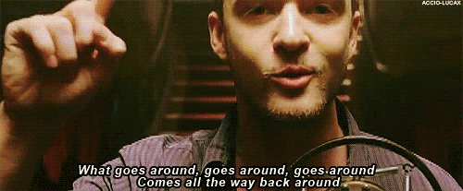
WHAT GOES AROUND, COMES AROUND.
Wrongdoing will be returned one way or another; good deeds will be rewarded.

